Slide 1
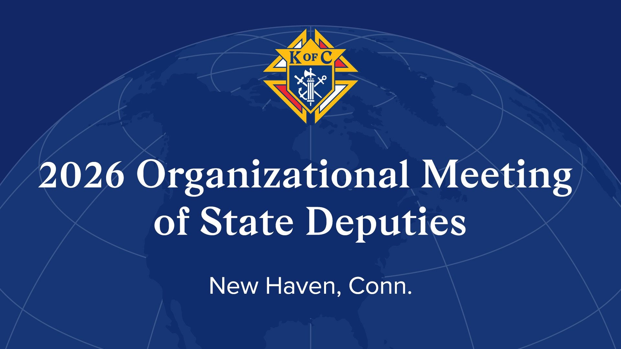

Slide 2




John Moulder
Vice President, Fraternal Operations
June 5, 2026

Slide 3
Fraternal Operations Mission
Strengthen the Order’s fraternal structure to improve council performance and drive mission alignment.

Slide 4
MISSION
Develop Disciples – Cor
Protect Catholic Families – Guard, Grow, Give
Support Parish / Community – Faith in Action
Evangelize – Culture of Invitation
Notes:
If we get this right, we will draw men to the Order / Protect Catholic families

Slide 5

EXPECTATIONS
“Treat a man as he is and he will remain as he is. Treat a man as he can and should be and he will become as he can and should be.”
- Stephen Covey
Notes:
Treat our DDs and GKs as they can and should be – some are fantastic, but many can be better

Slide 6

EXPECTATIONS
Goal #1 Unscored Upon
Goal #2 Undefeated
Goal #3 Championship
Notes:
To treat us as we can and should be – coach created a culture or an attitude of elite level success from the beginning

Slide 7

EXPECTATIONS
Goal #1 Every Council Star
Goal #2 Every Council Baseline
Goal #3 Earn COH / Pinnacle
Notes:
We pruned the nonfruit bearing branches

Slide 8



ACCOUNTABILITY
State Team – District Deputies – Grand Knights
Keep it Simple
Communicate and Educate
Leave no Council Behind
Notes:
If you want success do simple things well consistently / culture of invitation means every council recruiting every year / two ways to do that – personal invitation and draw men to a council – culture eats strategy

Slide 9

SUPPORT FOR YOUR SUCCESS
Data on council and district performance
Faith in Action refresh
Revised award criteria
Reduced paperwork
Updated Exemplification instructions
Coming in 2027

Slide 10
MISSION
Develop Disciples – Cor
Protect Catholic Families – Guard, Grow, Give
Support Parish / Community – Faith in Action
Evangelize – Culture of Invitation
Notes:
If we get this right, we will draw men to the Order / Protect Catholic families

Slide 11
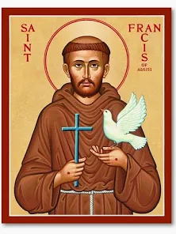
ONE STEP AT A TIME
“Start by doing what’s necessary; then do what’s possible; and suddenly you are doing the impossible””
- St. Francis of Assisi

Slide 12
Thank You!
Vivat Jesus!

Slide 14
The McGivney Leader Fellowship:
Forming Apostolic Leaders

Slide 15
Leader Development Vision
To make the Knights of Columbus an organization men join to become great leaders.

Slide 16
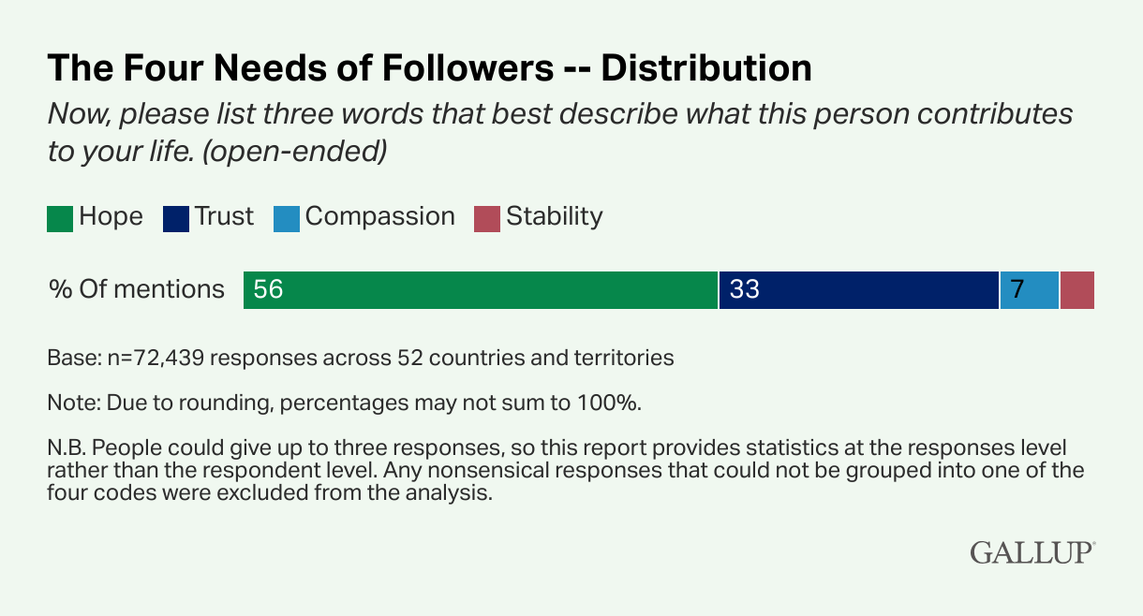
Gallup Survey on What Followers Need from Leaders

Slide 17
At the Intersection of Secular Research and Theological Insight

Slide 18
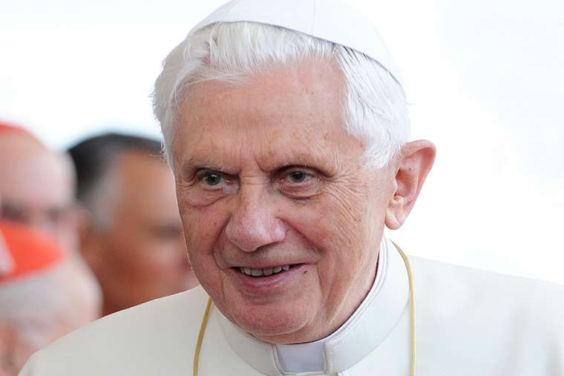
Pope Benedict XVI
Spe Salvi
Saved in Hope
“For we are saved by hope.”
(Romans 8:24)

Slide 19
How Does Hope Apply to Leadership?
Why do so many followers want hope?

Slide 20
Hope as the Goal
“A difficult present can be loved and accepted if it leads towards a goal. The goal must be sure and great to justify the effort.” Pope Benedict, Spe Salvi, 1
The greater the hope the greater the commitment of followers.

Slide 21
Does Christian hope differ from other types of hope?

