Slide 1
Notes:
Robby to start with highlevel reminders and vision for EFF and Cor
Hand off to Kyle and Renzo for Content
Hand off to Sean for EFF Infrastructure and Cor

Slide 2

Evangelization and Faith Formation

Slide 3
Cor: The Heart of our Mission

Slide 4
Catholic Men in Today’s World

Slide 5
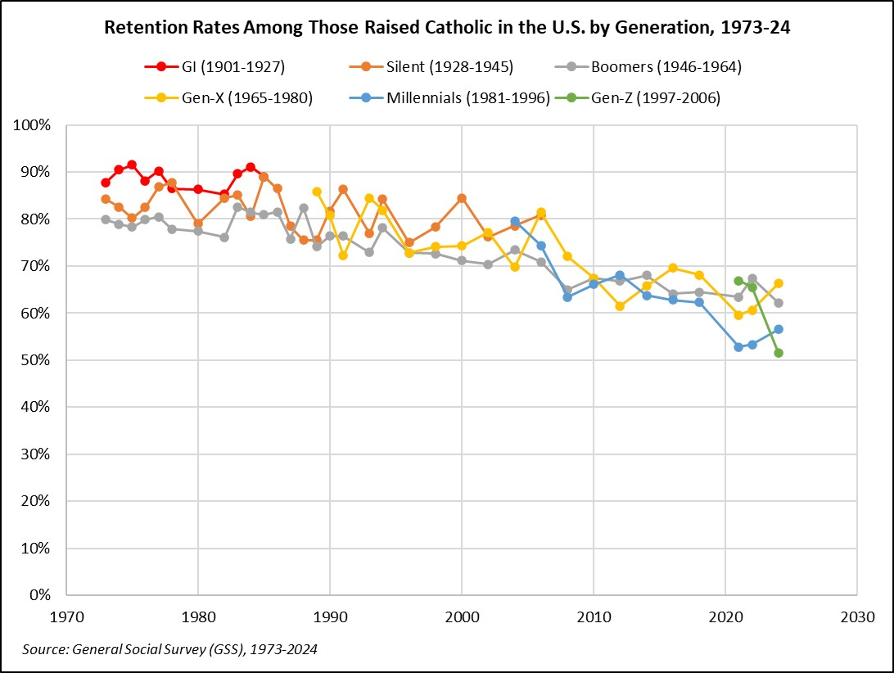
Retention Rates
Notes:
CARA: “Retention rates measure the percentage of adults who were raised Catholic who remain Catholics when surveyed as adults.”
As we see here, retention rates have steeply declined over the last half century
In 1973, all generations represented have a retention rate of around 80-90%
Today, both Gen Z and Millennials are approaching a retention rate of 50%
A massive collapse in retention rates
And remember, these are those who identify as Catholic – it says nothing about the level of practice
----------------------------------
Source: https://nineteensixty-four.blogspot.com/2026/03/talking-about-your-generation.html

Slide 6
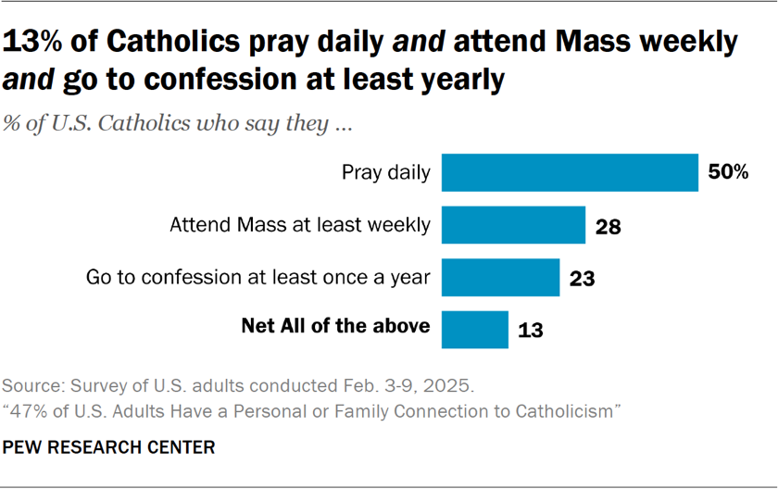
Level of Practice
  20% of adults in the U.S. identify as Catholic
  Many are very observant:
    50% pray daily
    28% attend Mass weekly (or more)
    23% go to Confession at least once during the year
  13% report they do all three
Notes:
Obviously many strong potential candidates to join the Knights
----------------------------------
Source: https://www.pewresearch.org/religion/2025/06/16/47-of-us-adults-have-a-personal-or-family-connection-to-catholicism/

Slide 7
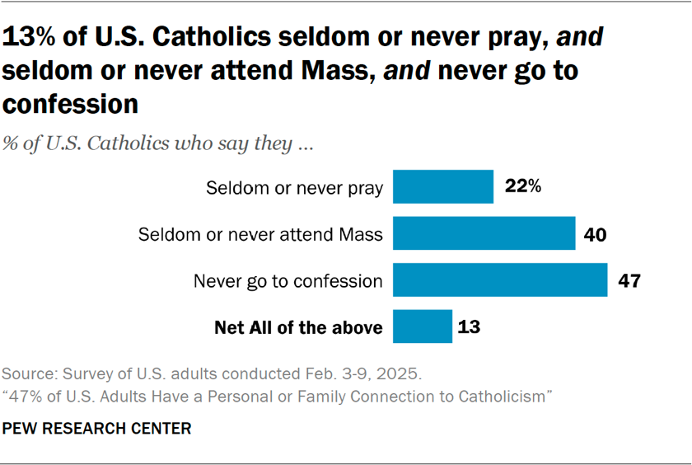
Level of Practice
  Many are largely nonobservant:
    22% seldom/never pray
    40% seldom/never attend Mass
    47% never go to Confession
  13% report they seldom/never pray, attend Mass, or go to confession
  74% fall somewhere in between these two groups
Notes:
Those who are nonobservant are probably less likely to be interested in being a Knight, but (to varying degrees) many in the middle certainly would
Overall, there is a lot of opportunity for recruitment
----------------------------------
Source: https://www.pewresearch.org/religion/2025/06/16/47-of-us-adults-have-a-personal-or-family-connection-to-catholicism/

Slide 8

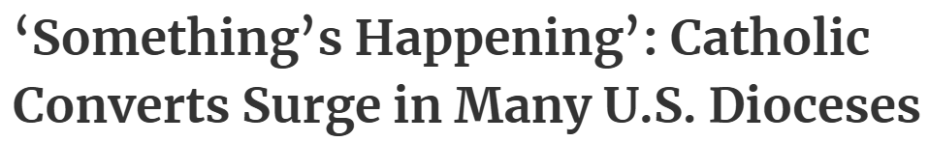
Reports of Signs of Hope
  The Supreme Knight has highlighted a crisis of isolation among men
  Amid this crisis – in part as a reaction to it? – there are signs of hope
  Many dioceses in the U.S. saw significant increases in converts entering the Church at Easter 2026
  Anecdotal reports abound of increased interest in religion generally – and Catholicism particularly
  But what does the data tell us?
Notes:
You are probably broadly familiar with the realities of the data just discussed – and the challenges it presents – but the culture seems to be shifting
Many are talking about a “religious revival,” but what is actually happening out there

Slide 9
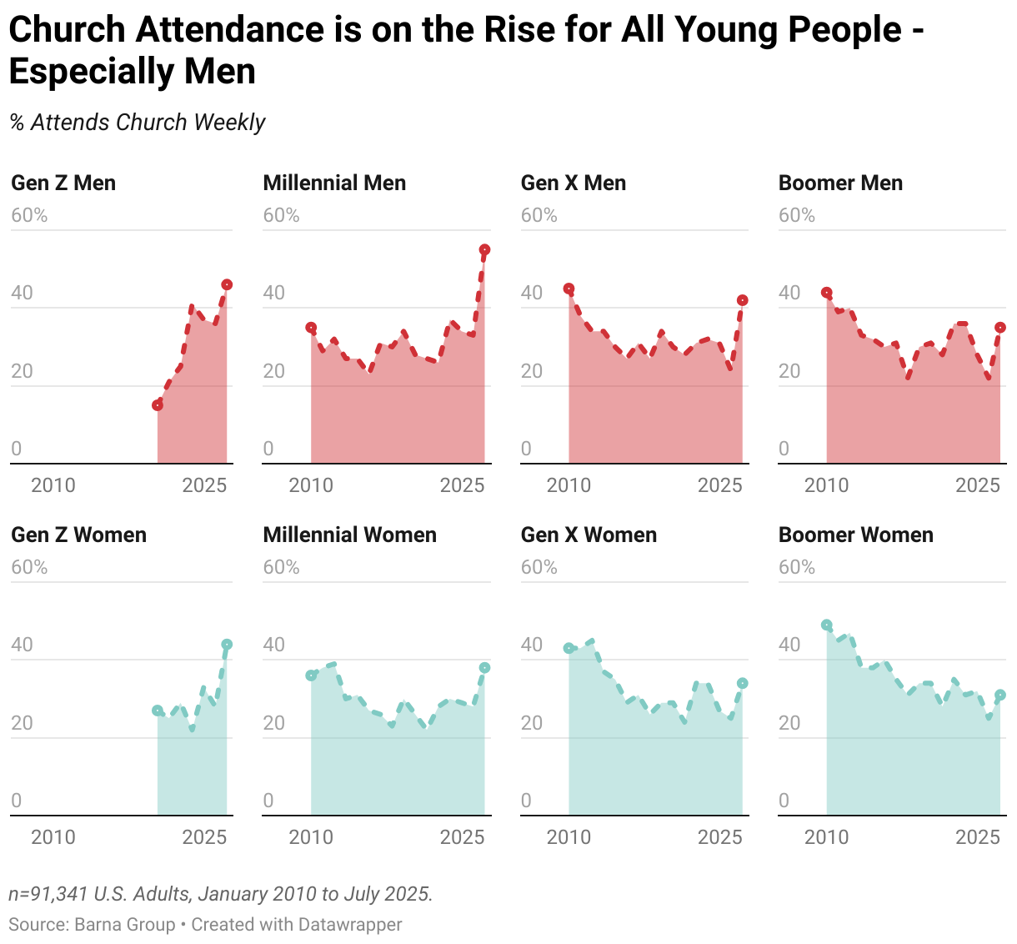
Weekly Church Attendance Rising
Notes:
Barna: “Regular church attendance is on the rise for all young adults. Since 2019 both Gen Z and Millennials were the least likely generation to frequently attend church. Today, they are the most engaged… Though there’s a slight uptick in attendance among older generations, their weekly attendance… lags far below younger adults.”
[Explain Chart: Rise in weekly church attendance for all generations of both men and women, with the young having the highest attendance]
It’s important to note this is “regular church attendance” or those who attend weekly
There are other metrics where younger generations are more irreligious than older generations (i.e., younger Americans are more likely to identify as “nones”)
Nevertheless, this clearly shows more people in every generation are becoming regular churchgoers – with younger generations the most engaged
Amazing good news – but there is something else as well
Barna: “Across every generation, women are trailing men in weekly church attendance, especially among Gen X and Millennials.“
[Explain chart: Men (especially young men) are more engaged than women]
----------------------------------
Source: https://www.barna.com/trends/church-attendance-women-men/

Slide 10
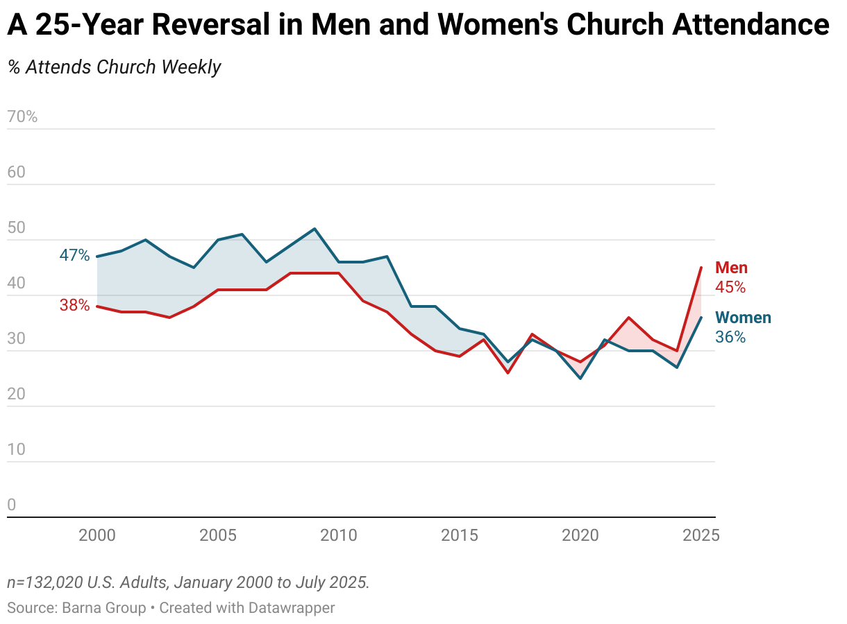
Men Attend Church Weekly More Frequently than Women
Notes:
This is another major trend with special relevance to the Knights
So, since 2022, men report attending church weekly more frequently than women
A major reversal
[Explain chart]
----------------------------------
Source: https://www.barna.com/trends/church-attendance-women-men/

Slide 11
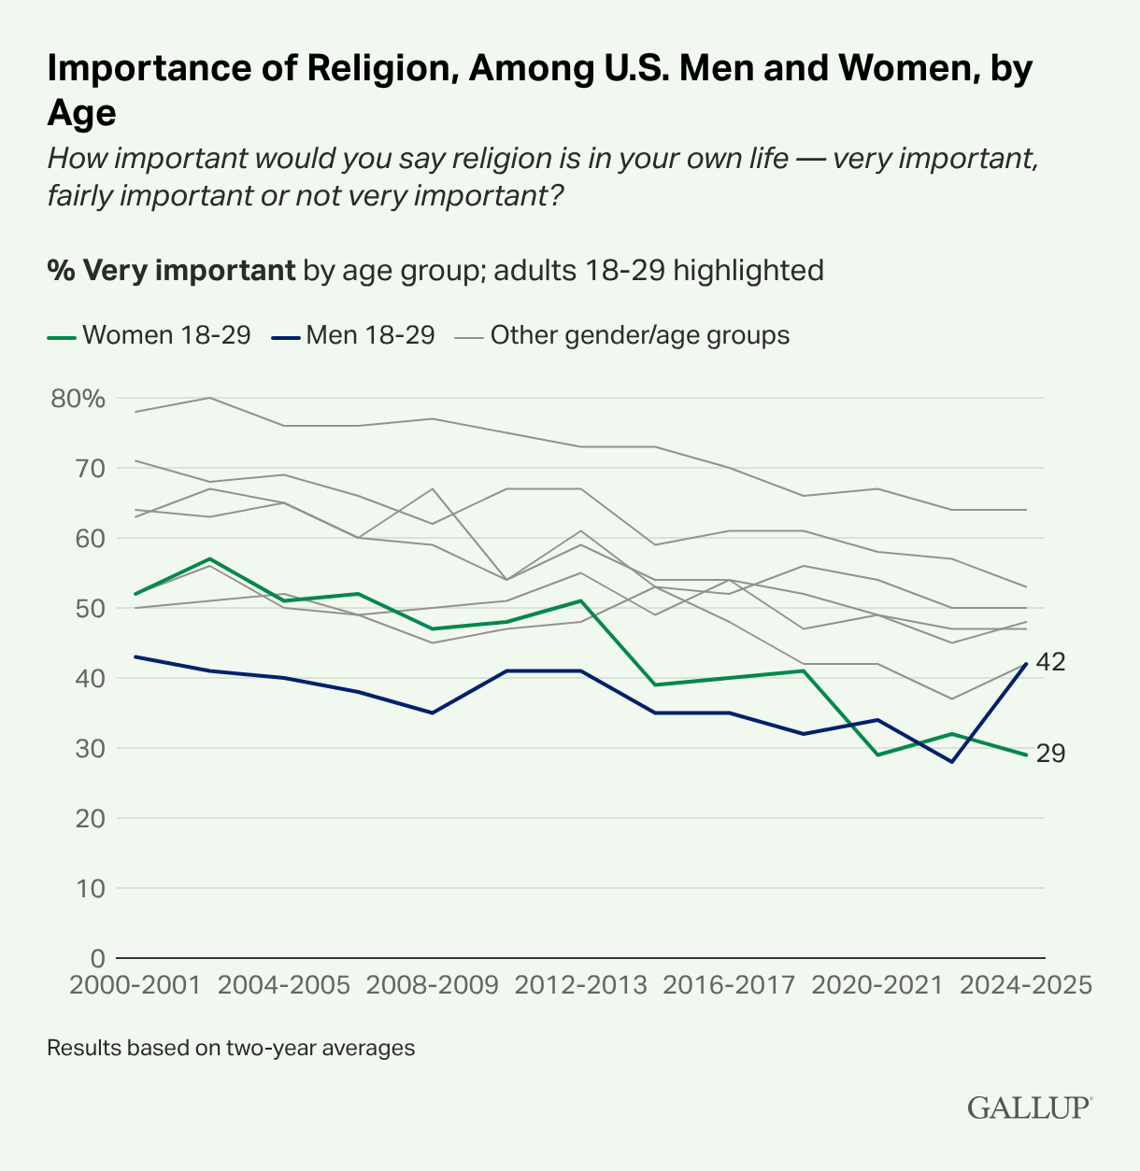
Religion “Very Important” to More Young Men than Women
Notes:
We also see a similar reversal on the importance of religion in the lives of young men and women
The number of men 18-29 saying religion is “very important” in their life has jumped from 28% to 42% in the last few years
Only 29% of women in the same age group report religion is very important in their life
Another major reversal
----------------------------------
Source: https://news.gallup.com/poll/708410/rise-young-men-religiosity-realigns-gender-gaps.aspx

Slide 12
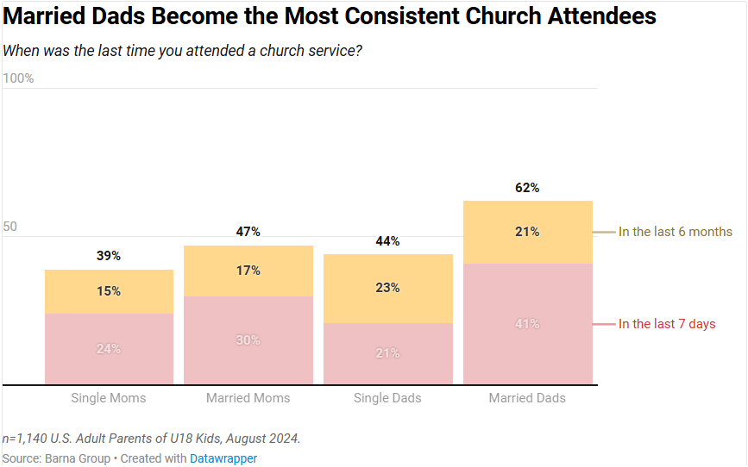
Married Fathers Most Likely to Attend Church Weekly
Notes:
Barna: “Among today’s parents, married dads are now the most likely to attend church weekly, a finding that marks a striking shift from previous norms.”
[Skip explaining graph]
----------------------------------
Source: https://www.barna.com/trends/church-attendance-women-men/

Slide 13
The Bottom Line
There is a decline in retention rates among Catholics
While many Catholics are very observant in their faith, many are nonobservant
Nevertheless, there is renewed interest and engagement with religion across all generations
Young men and married fathers are now the most engaged
Notes:
Great news for the Knights of Columbus
Young men are the future of the Order
Married fathers are the core of the Order

Slide 14
What Does This Mean for Us as Knights?
The Church faces many challenges today
Despite these challenges, there are signs of new opportunities – new reasons for hope
The Knights must be at the forefront of these positive trends
Cor offers councils the space and the tools to meet the needs – and increasingly the desires – of Catholic men
Especially young men and fathers
Notes:
These new trends are creating huge opportunities for the Knights to recruit and form young men and fathers – and all men
I’ll now turn it over to Sean Pott, Director of Evangelization and Education, to update us on the Order’s efforts with Cor to position us to be at the forefront of this fight

Slide 15
Cor Support &
EFF Team Training

Slide 16
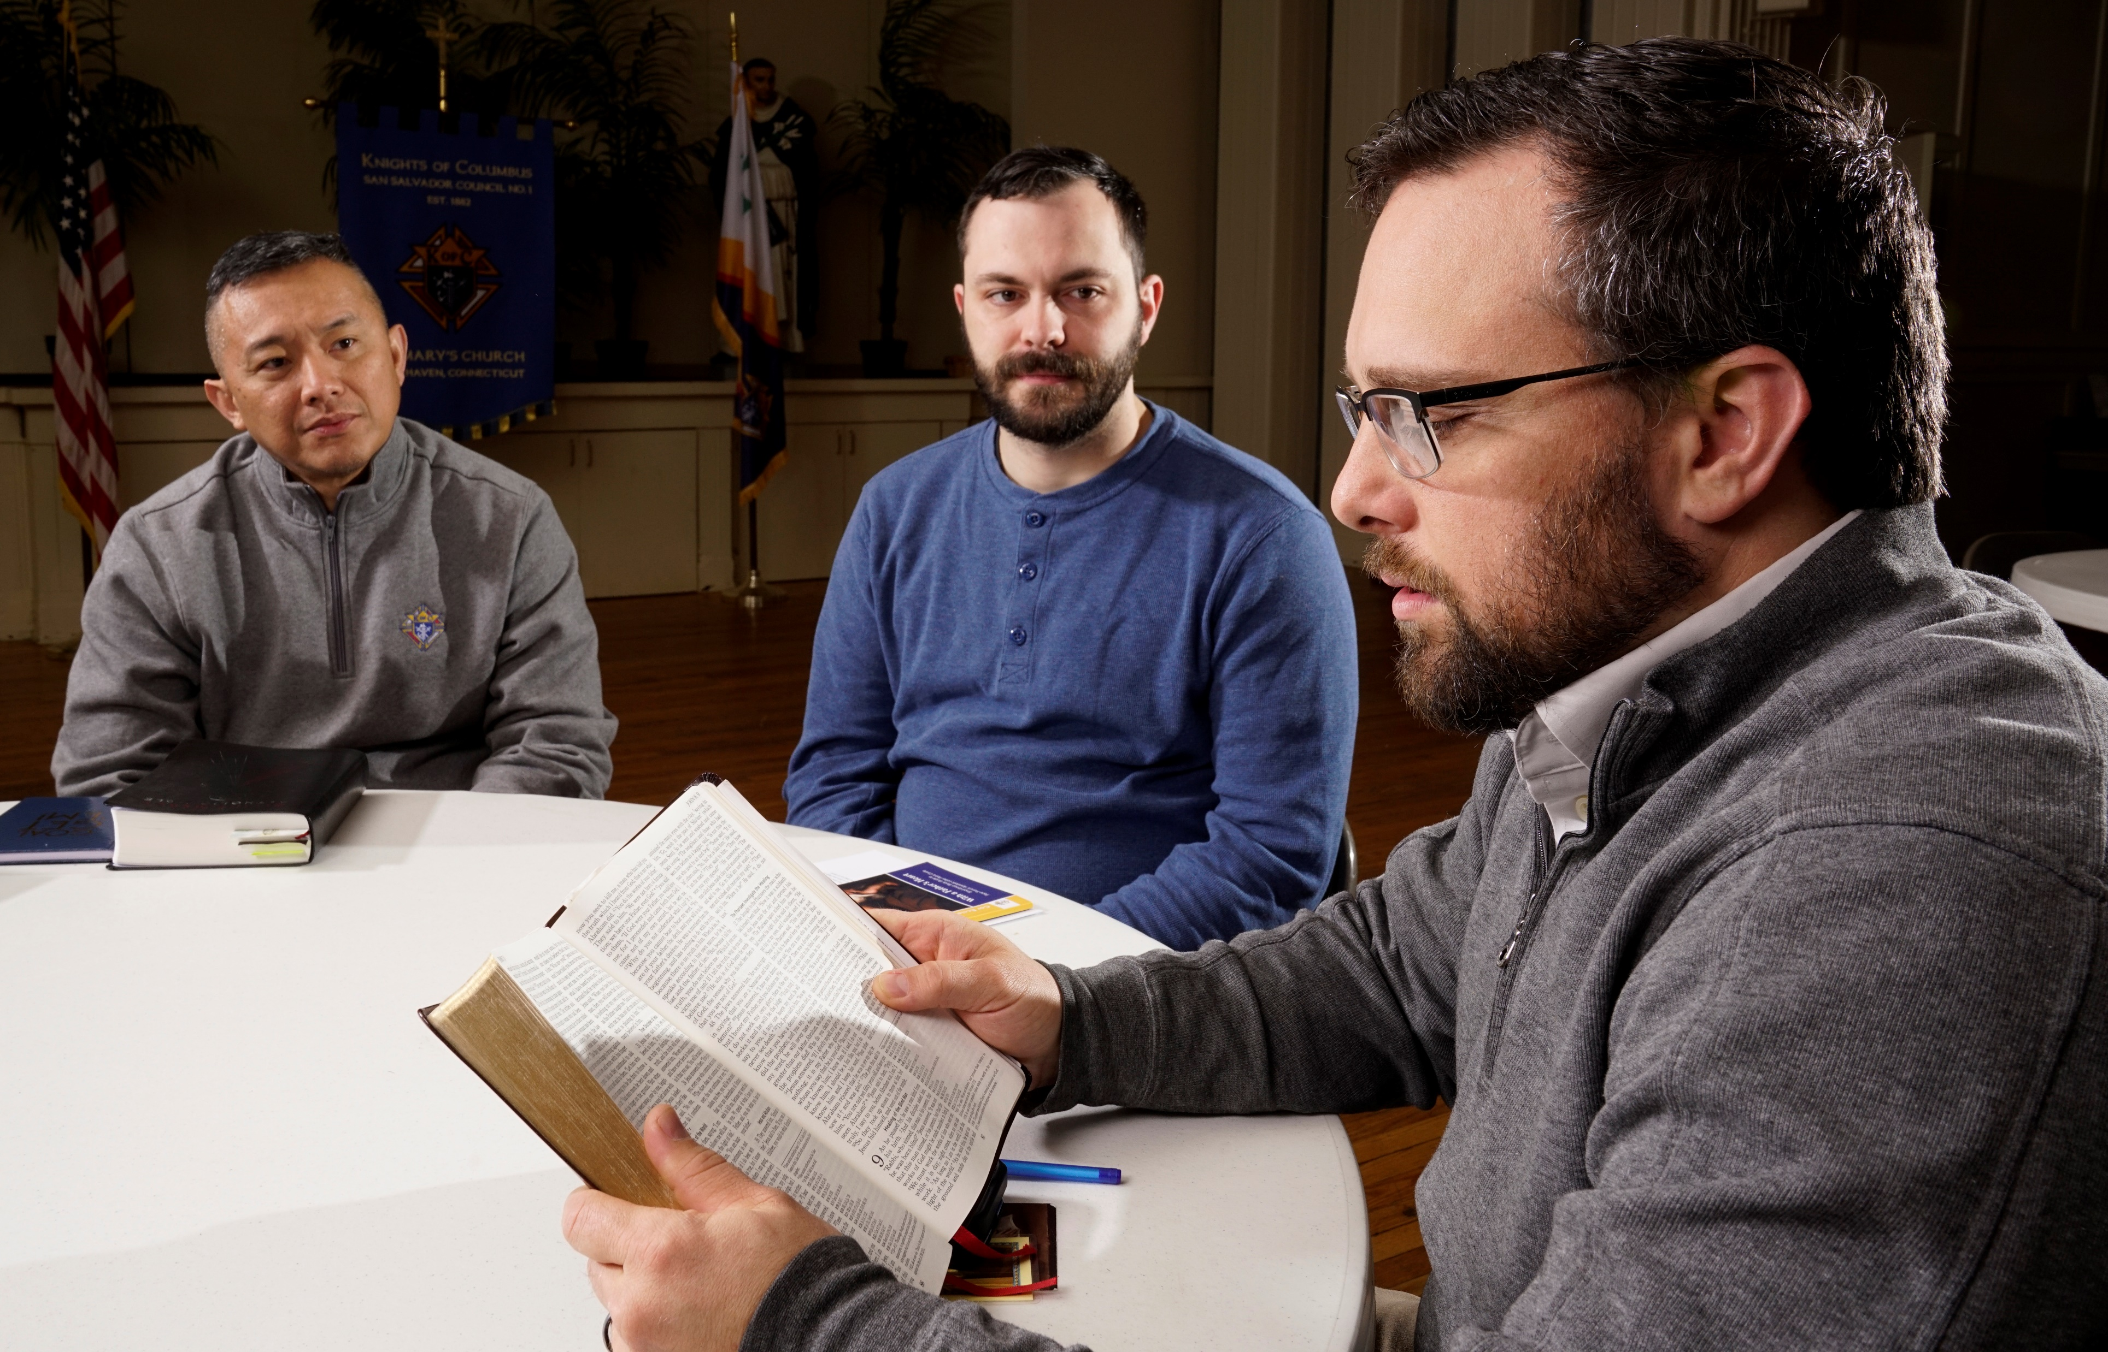
What is Cor ?
Cor is a regular gathering of men that uses a flexible framework of prayer, formation and fraternity to foster Christ-centered brotherhood and help men grow closer to Jesus.
Notes:
Lindsay –
Cor is designed to create the intentional space to build Christ-centered brotherhood through a flexible framework of 3 key elements (prayer, formation, fraternity).
Notice how the focus is on building lasting brotherhood, not on a limited-time formation or prayer goal.

Slide 17
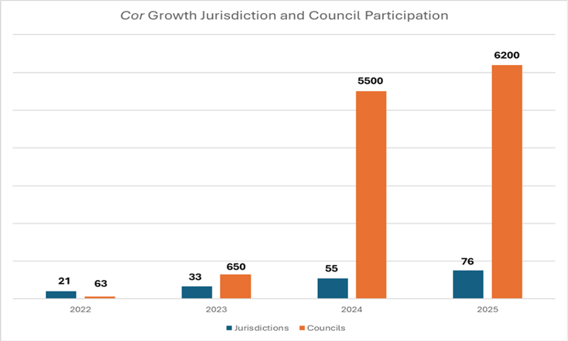
Cor growth over past 3 years
  Reporting: 76 Jurisdictions, 6200 councils
    10,000% increase from 60 councils in 2022/2023 Fraternal year
    If average of 16 attendees holds from pilot year, we are just shy of 100,000 men
Notes:
Lindsay –
Cor is designed to create the intentional space to build Christ-centered brotherhood through a flexible framework of 3 key elements (prayer, formation, fraternity).
Notice how the focus is on building lasting brotherhood, not on a limited-time formation or prayer goal.

Slide 18
Cor Data Sources
Forms:
DD Annual Report Form #944
Council EFF Director Submission Form
Columbian Award SP-7
Fraternal Annual Report #1728
State 365 and Future Council 365
Monthly Reports:
Quarterly Report
Notes:
Lindsay –
Cor is designed to create the intentional space to build Christ-centered brotherhood through a flexible framework of 3 key elements (prayer, formation, fraternity).
Notice how the focus is on building lasting brotherhood, not on a limited-time formation or prayer goal.

Slide 19
State EFF Infrastructure
State Level
—
Diocesan Level
—
Council Level
—
State EFF Director
State Chaplain
  Diocesan EFF Coordinator
  Associate State Chaplain
Council EFF Director

Slide 20
Support for State EFF Directors
September State EFF Training
—
Quarterly Calls
—
EFF Team Support
—
State EFF Director & Diocesan Coordinator
Combining with McGivney Fellows
Rollout new training modules
Focus on providing in-person training experience per diocese
Every quarter all State EFF Directors, State Chaplains, and RGDs/TGDs are invited to a quarterly call for updates and progress reporting
Sharepoint Access and Data/Report sharing
Supreme EFF Team provide email support and engagement
Raul Chavez – Bilingual State Evangelization and Faith Formation Specialist

Slide 21
Support for Council EFF Directors
Resources
—
Communication
—
Training & Formation
—
Newly updated leader's webpage
New Leader Guide
New Tri-folds
New marketing resources
New formation and prayer content
  Onboarding email campaign
  Fraternal Leader Advisory section
  Quarterly Newsletter
Startup Videos
Webinar and State Training access
New ongoing formation and training – Men’s Day of Formation

Slide 22
Key Take Aways
We need:
Increased Leadership reporting:
    Confirm State EFF Director
    Remind Council EFF Director Report Form
    Diocesan EFF Coordinator
Consistency of messaging
Notes:
Lindsay –
Cor is designed to create the intentional space to build Christ-centered brotherhood through a flexible framework of 3 key elements (prayer, formation, fraternity).
Notice how the focus is on building lasting brotherhood, not on a limited-time formation or prayer goal.

Slide 23
Formation Content
Notes:
ME/WE
- The Knights must be at the forefront of these positive trends
Cor offers councils the space and the tools to meet the needs – and increasingly the desires – of Catholic men, young husbands and fathers
Fill the formation needs of these young husband and fathers

Slide 24
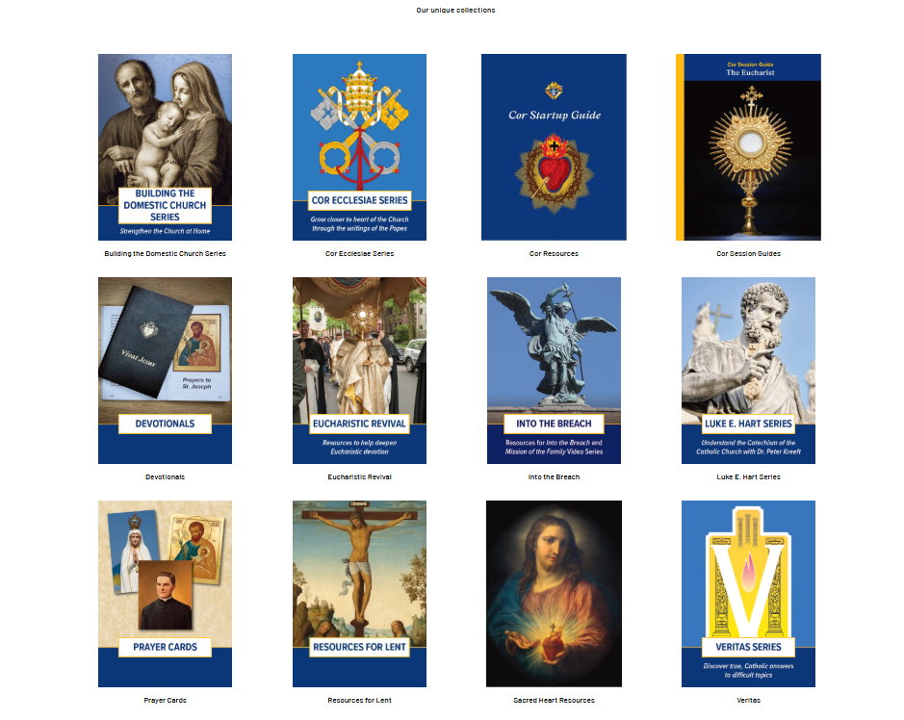
Catholic Information Service –
KofC.org/shopcis
  Catholic Information Service provides faithful, accessible low-cost faith formation resources for individuals, families, councils, and parishes.
Notes:
G
Content for individual Knights, their families, and for integration into Cor.

Slide 25
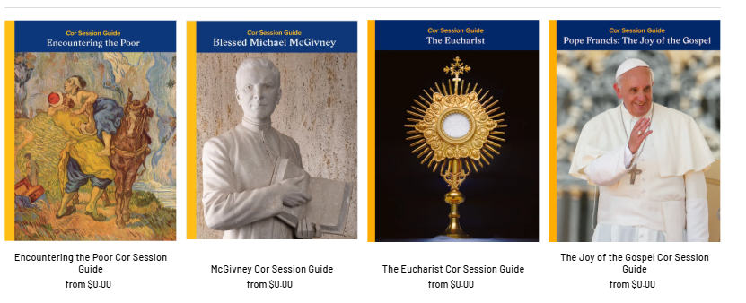
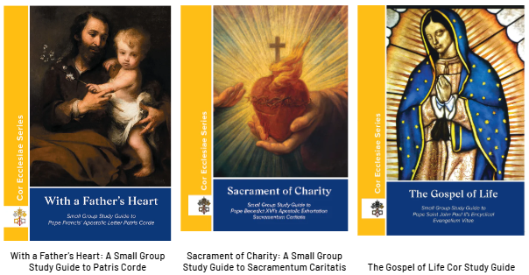
Cor Session Guides
CIS Content for Cor – ​KofC.org/shopcis
  Provides councils with faith formation guides made to seamlessly fit in Cor
Cor Ecclesiae Series
  The Cor Ecclesiae Series provides study and discussion guides for Church documents so groups can grow closer to Jesus Christ in the heart of the Church (Cor Ecclesiae)
Notes:
The formation content that we've compiled for you fits perfectly into Cor, and is unique because it forms our men so they can go out and serve

Slide 26
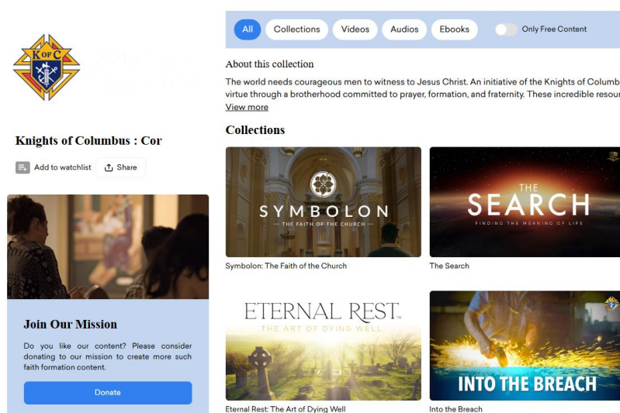
Augustine Institute’s “Formed” Streaming Service
    Formed’s award-winning content is available to support formation in Cor
    All State Deputies, State Chaplains, State EFF Directors, and Council EFF Directors have free access to Formed
    Recommended Cor content on K of C content page
    To sign up: kofc.org/formed

Slide 27
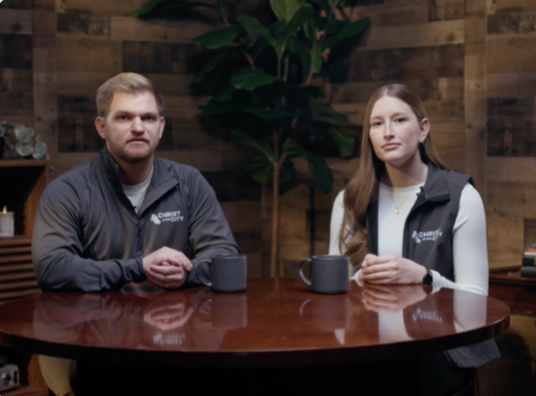
Encountering the Poor: A Knights of Columbus Training Series
Three-part video series
Equips Knights with insights and practical tools for serving the poor
Developed with Christ in the City, a Catholic ministry dedicated to forming volunteers to serve the poor
Invites Knights to go deeper in the charitable work they already do
Companion study guide for Cor
Kofc.org/encounteringthepoor
Notes:
Available in Spanish and French (this month)

Slide 28

Into the Breach: The Dignity of Work
Latest entry in the Into the Breach video series
Explores the Catholic vision of man’s mission in the world, focused on the role of work
Five episodes
Optimized for Cor
Companion study guide
Promotion resources
www.kofc.org/intothebreach
Notes:
Available in Spanish and French (this month)
Use to launch Cor

Slide 29
Heart of the Gospel

Slide 30

Heart of the Gospel Retreat
“Retreat in a box” in partnership with Acts XXIX
    Dynamic presentation of Kerygma – Gospel basics
Day long, little to no cost for parish
Cor pre- and post-retreat sessions
Retreat resources
    Leader and Retreatant Guide
    Designed as a plug-n-play
    Website – www.kofc.org/gospel
Notes:
All the pieces you need for excellent retreat
Fr. John Riccardo’s apostolate; incredibly dynamic presentation of Kerygma
Comprehensive guides, no special training
Follow the script, hit play and stop – facilitate a high-quality retreat
Need pastor’s permission

Slide 31
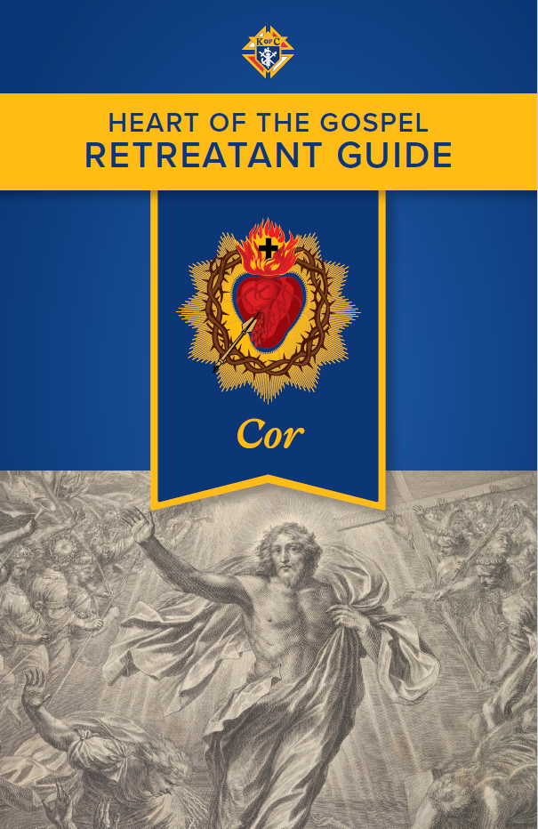
Heart of the Gospel Retreat
  Supports Faith Programs – Spiritual Reflection
    Must fulfill regular requirements
  Available now in English – Spanish and French in development
  Jumpstart, reinvigorate, or supercharge Cor
    For all men of the parish; introduction to the Order
Notes:
Never done this before!
Some men who have not joined the Order may be pleasantly surprised
Kindly ask you to preview the first Talk

Slide 32
Main Action Items

Slide 33
What we are asking from you:
  Pray for the men and leaders of your jurisdiction EVERY DAY
  Appoint and Report State EFF Director and empower him to build out the diocesan team
  Continue promoting Cor with a compelling narrative
  Review state Cor and EFF leader Data in Sharepoint
  Encourage Council EFF Director Reporting

Slide 34
Org Meeting Prep. – State EFF Director
  Ask your State EFF Director to:
  Encourage Council EFF Director Reporting
  Identify and invite Diocesan EFF Coordinators
  Promote Heart of the Gospel to be used for Spiritual Reflection Program
  Promote Into the Breach: The Dignity of Work – Use this to kick off Cor
  Share www.kofc.org/shopcis to order formation content

Slide 35
Thank You

