Slide 1
Fraternal Operations Workshop

Slide 2
Fraternal Operations
Fraternal Training & Communications
Ceremonials & Council Experience
Programs
(Faith In Action)
Military & College Operations
Training
Officer Communications
Webinar & Video Production
Resource Development
Budgets
Ceremonials
Council Performance
District/Council Data
Program Management
Program Development
Military Council Management
College Council Management
Veterans Affairs Operations
Warriors to Lourdes
Fraternal Technology Support
IT Liaison

Slide 3
Agenda
Council/District Health Reports
Faith In Action Updates
Operations Updates
Award Updates
Q & A

Slide 4
Council/District Health Reports

Slide 5




Connecticut
Council Health Dashboard
COUNCIL STATUS
STATUS | Count | Members
Total Councils | 162 | 18,418
Active Councils | 158 | 17,805
Councils Pending Suspension | 0 | 0
Suspended Councils | 4 | 612
Current Council Health
12%
GROWTH METRICS
METRIC | Count | Percent
Councils Recruiting This FY | 120 | 74%
New Members Recruited | 559
New Councils/Reactivations YTD | 1
29%
59%
CURRENT COUNCIL AWARDS
AWARD | Count | Percent
Star Council | 0 | 0%
Father McGivney Award | 16 | 10%
Founders’ Award | 21 | 13%
Columbian Award | 0 | 0%
COUNCIL LEADERSHIP
STATUS | Count | Percent
Grand Knight on file | 155 | 96%
No Grand Knight on file | 7 | 4%
Financial Secretary on file | 159 | 98%
No Financial Secretary on file | 3 | 2%
Baseline Councils Functioning Councils At Risk Councils
SUSPENDED COUNCILS
SUSPENSION LENGTH | Count | Members
< 5 Years Suspended | 3 | 587
5-10 Years Suspended | 0 | 0
10+ Years Suspended | 1 | 25
COUNCIL HEALTH
HEALTH STATUS | Count | Members
Baseline Councils | 95 | 12,188
Functioning Councils | 47 | 4,798
At Risk Councils | 20 | 1,431
At Risk Councils - What is Missing to become Functioning
Missing Recruitment Only | Missing 1728 Only | Missing Payment Only | Missing FS Only | Missing 185 Only | Missing 365 Only
5 | 10 | 0 | 0 | 0 | 5
FORM SUBMISSIONS
FORM | Count | Percent
Form 185 Received | 155 | 96%
Form 365 Received | 143 | 88%
Form 1728 Received | 128 | 79%
Councils Reporting Cor YTD | 9 | 6%
COUNCIL HEALTH - WEEK PRIOR
HEALTH STATUS | Count | Members
Baseline Councils | 93 | 12,006
Functioning Councils | 47 | 4,657
At Risk Councils | 22 | 1,754
Functioning Councils - What is Missing to become Baseline
Missing Recruitment Only | Missing 1728 Only | Missing Payment Only | Missing FS Only | Missing 185 Only | Missing 365 Only
27 | 14 | 1 | 1 | 0 | 4

Slide 6
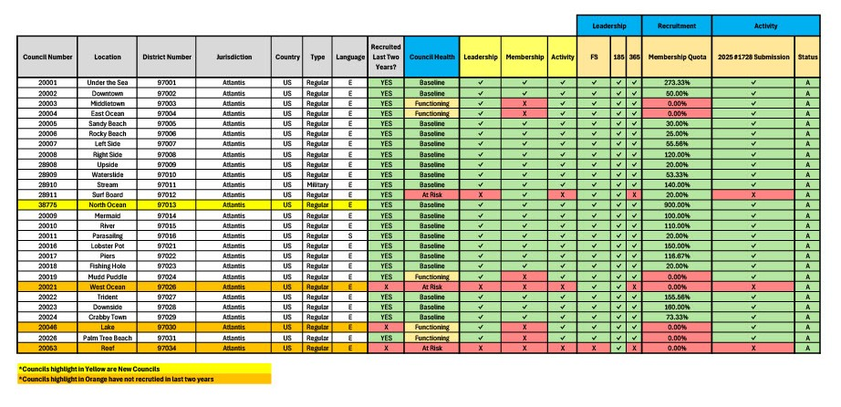
Council Data Extract

Slide 7


Tennessee
District Health Dashboard
DISTRICT STATUS
STATUS | Count | Councils
Total Districts | 21 | 94
Unassigned Districts - No Councils | 0 | 0
Unassigned Districts - With Councils | 0 | 0
Current District Health
DISTRICTS WITIH SUSPENDED COUNCILS
SUSPENSION LENGTH | Count | Councils
< 5 Years Suspended | 0 | 0
5-10 Years Suspended | 0 | 0
10+ Years Suspended | 0 | 0
19%
33%
48%
FORM SUBMISSIONS
FORM | Count | Percent
ALL 944 Forms Rec'd | 18 | 86%
ALL Form 185 Received | 21 | 100%
ALL Form 365 Received | 19 | 90%
ALL Form 1728 Received | 10 | 48%
Districts Reporting Cor | 4 | 19%
DISTRICT HEALTH
HEALTH STATUS | Count | Councils
Baseline Districts | 7 | 30
Functioning Districts | 10 | 46
At Risk Districts | 4 | 18
Baseline Districts At Risk Districts
Functioning Districts
DISTRICT HEALTH - WEEK PRIOR
HEALTH STATUS | Count | Councils
Baseline Districts | 4 | 19
Functioning Districts | 2 | 8
At Risk Districts | 1 | 5
At Risk Districts - What is Missing to become Functioning
Missing Recruitme nt | Missing 1728 | Missing Active Councils 100% | Missing FS | Missing 185 | Missing 365
4 | 4 | 0 | 1 | 0 | 1
DISTRICTS WITH COUNCILS MISSING OFFICERS
OFFICER | Count | Percent
Missing Form 185 | 0 | 0%
Missing Finacial Secretary | 1 | 5%
DISTRICT SIZES
TOTAL COUNCILS | Count | Percent
Zero Councils | 0 | 0%
1 or 2 Councils | 1 | 5%
3 to 5 Councils | 16 | 76%
6 or more Councils | 4 | 19%
Functioning Districts - What is Missing to become Baseline
Missing Recruitme nt | Missing 1728 | Missing Active Councils 100% | Missing FS | Missing 185 | Missing 365
3 | 7 | 0 | 0 | 0 | 0
AWARDS PROGRESS CURRENT YEAR
METRIC | Count | %
Districts min. one Star Council | 0 | 0%
Star Districts | 0 | 0%
All-Star Districts | 0 | 0%

Slide 8
District Data Extract
 |  |  |  |  |  |  |  |  |  |  |  | Council Assessment |  |  | Leadership |  |  | Recruitment | Activity
Jurisdictio n | Country | District | District Health Assessment | Total Councils | Active Councils | Suspende d Councils | 944 Submitt ed | 944 Submissi on % | District Members hip Quota | District Members hip YTD Gains | District Members hip Quota % | Baseline | Functioning | At Risk | FS | 185 | 365 | 75% of Councils with Recruitment | 2025 1728 Submissi on | All Councils with Active Status
41 | US | 41001 | FUNCTIONING | 4 | 4 | 0 | 4 | 100% | 27 | 19 | 71% | 1 | 1 | 2 | ✓ | ✓ | ✓ | ✓ | X | ✓
41 | US | 41002 | FUNCTIONING | 4 | 4 | 0 | 4 | 100% | 19 | 28 | 148% | 1 | 2 | 1 | ✓ | ✓ | ✓ | ✓ | X | ✓
41 | US | 41003 | AT RISK | 5 | 5 | 0 | 5 | 100% | 26 | 8 | 31% | 0 | 4 | 1 | ✓ | ✓ | ✓ | X | X | ✓
41 | US | 41004 | AT RISK | 6 | 6 | 0 | 5 | 83% | 22 | 24 | 107% | 1 | 3 | 2 | ✓ | ✓ | ✓ | X | X | ✓
41 | US | 41005 | AT RISK | 4 | 4 | 0 | 4 | 100% | 14 | 1 | 7% | 0 | 3 | 1 | X | ✓ | ✓ | X | X | ✓
41 | US | 41006 | BASELINE | 2 | 2 | 0 | 0 | 0% | 15 | 5 | 34% | 0 | 2 | 0 | ✓ | ✓ | ✓ | ✓ | ✓ | ✓
41 | US | 41007 | FUNCTIONING | 4 | 4 | 0 | 0 | 0% | 18 | 25 | 137% | 0 | 2 | 2 | ✓ | ✓ | ✓ | ✓ | X | ✓
41 | US | 41008 | FUNCTIONING | 4 | 4 | 0 | 4 | 100% | 14 | 1 | 7% | 0 | 4 | 0 | ✓ | ✓ | ✓ | X | ✓ | ✓
41 | US | 41009 | BASELINE | 5 | 5 | 0 | 5 | 100% | 32 | 38 | 118% | 2 | 3 | 0 | ✓ | ✓ | ✓ | ✓ | ✓ | ✓
41 | US | 41010 | FUNCTIONING | 5 | 5 | 0 | 5 | 100% | 25 | 24 | 98% | 1 | 2 | 2 | ✓ | ✓ | ✓ | ✓ | X | ✓
41 | US | 41011 | BASELINE | 4 | 4 | 0 | 4 | 100% | 24 | 35 | 147% | 1 | 3 | 0 | ✓ | ✓ | ✓ | ✓ | ✓ | ✓
41 | US | 41012 | BASELINE | 5 | 5 | 0 | 5 | 100% | 29 | 55 | 187% | 3 | 2 | 0 | ✓ | ✓ | ✓ | ✓ | ✓ | ✓
41 | US | 41013 | FUNCTIONING | 4 | 4 | 0 | 4 | 100% | 25 | 10 | 40% | 0 | 4 | 0 | ✓ | ✓ | ✓ | X | ✓ | ✓
41 | US | 41014 | FUNCTIONING | 5 | 5 | 0 | 5 | 100% | 20 | 12 | 59% | 0 | 5 | 0 | ✓ | ✓ | ✓ | X | ✓ | ✓
41 | US | 41015 | BASELINE | 5 | 5 | 0 | 5 | 100% | 33 | 59 | 179% | 3 | 2 | 0 | ✓ | ✓ | ✓ | ✓ | ✓ | ✓
41 | US | 41016 | FUNCTIONING | 6 | 6 | 0 | 6 | 100% | 30 | 27 | 90% | 0 | 3 | 3 | ✓ | ✓ | ✓ | ✓ | X | ✓
41 | US | 41017 | BASELINE | 6 | 6 | 0 | 6 | 100% | 34 | 29 | 86% | 1 | 5 | 0 | ✓ | ✓ | ✓ | ✓ | ✓ | ✓
41 | US | 41018 | FUNCTIONING | 6 | 6 | 0 | 6 | 100% | 32 | 48 | 149% | 0 | 6 | 0 | ✓ | ✓ | ✓ | ✓ | X | ✓
41 | US | 41019 | FUNCTIONING | 4 | 4 | 0 | 4 | 100% | 15 | 17 | 110% | 1 | 2 | 1 | ✓ | ✓ | ✓ | ✓ | X | ✓
41 | US | 41020 | BASELINE | 3 | 3 | 0 | 3 | 100% | 15 | 21 | 136% | 1 | 2 | 0 | ✓ | ✓ | ✓ | ✓ | ✓ | ✓
41 | US | 41021 | AT RISK | 3 | 3 | 0 | 3 | 100% | 11 | 0 | 0% | 0 | 1 | 2 | ✓ | ✓ | X | X | X | ✓

Slide 9
Faith In Action Updates

Slide 10
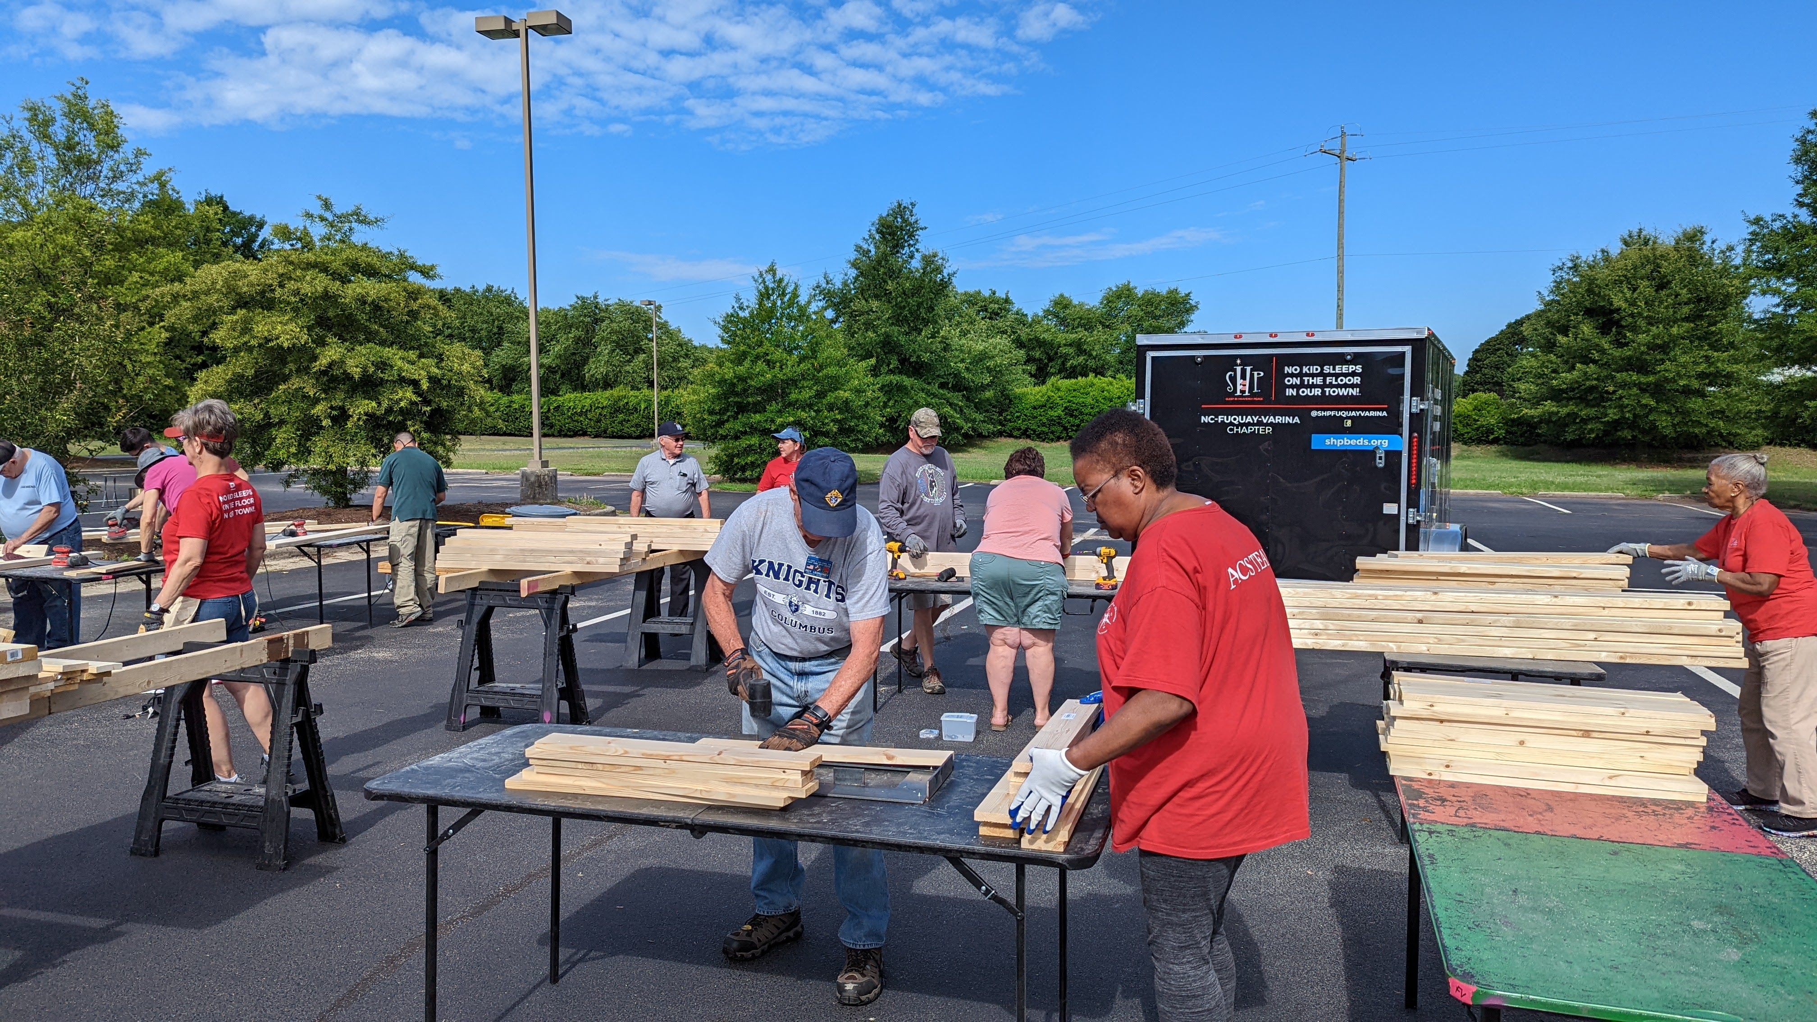
Goals
Focus on our best programs
  Streamline resources
Process
  Remove low-performers
  Eliminate redundancies
  Add more engaging programs

Slide 11
Removed
Family Week
Good Friday Family Promotion
Habitat for Humanity
Combined
Family Fully Alive → Family Prayer Night
Novena for Life → Gospel of Life
Pregnancy Center Support → ASAP

Slide 12
Added
Build-a-Bed (Family)
Quinceañera Support (Family)
Remembering Our Faithful Departed (Family)
Imitating Saint Juan Diego (Faith)
¡Viva Cristo Rey! (Faith)
Bright Futures (Community)
Celebrating Our Catholic Heritage (Community)
Gospel of Life (Life)
Holy Hour for Life with Our Lady of Guadalupe (Life)
Other
Moving Building the Domestic Church Kiosk to Family category

Slide 13

Results
    Simplified program offerings
    Improved member experience

Slide 14
Operations Updates

Slide 15
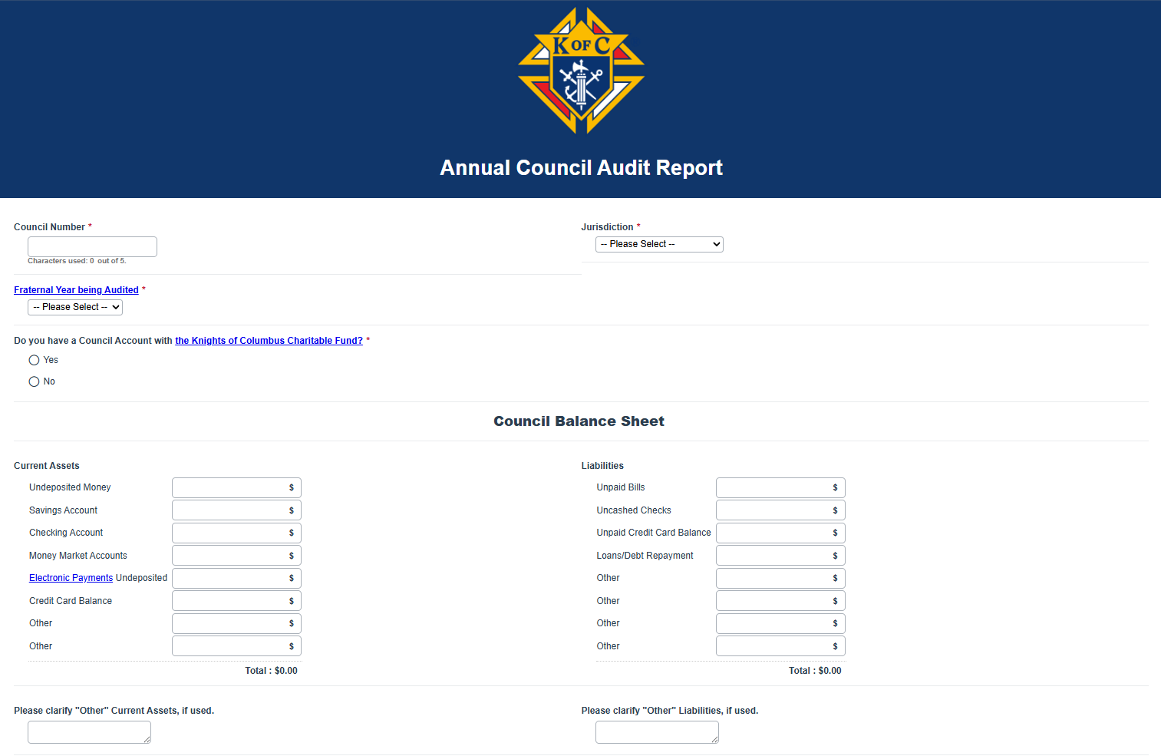
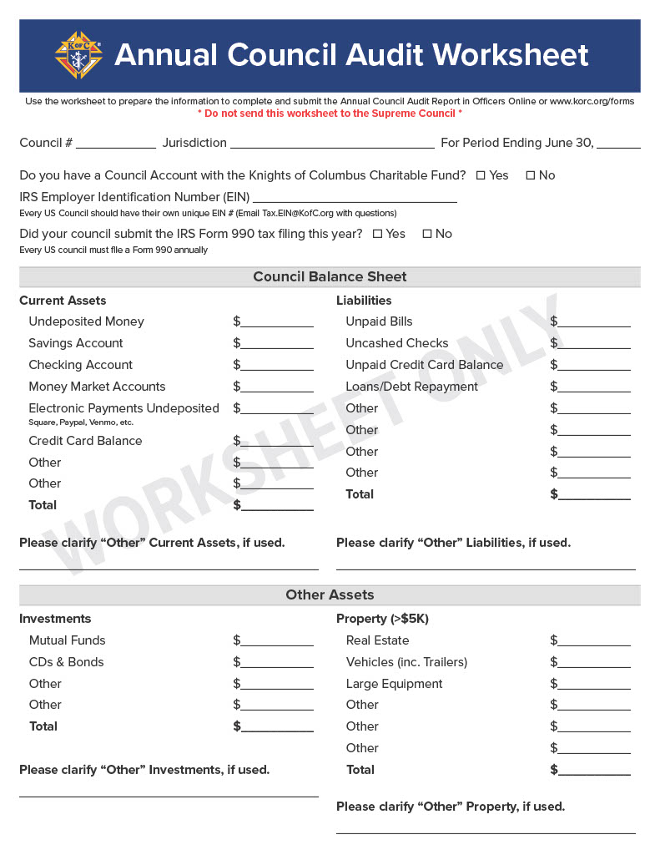

Annual Audit Resources
www.kofc.org/forms

Slide 16
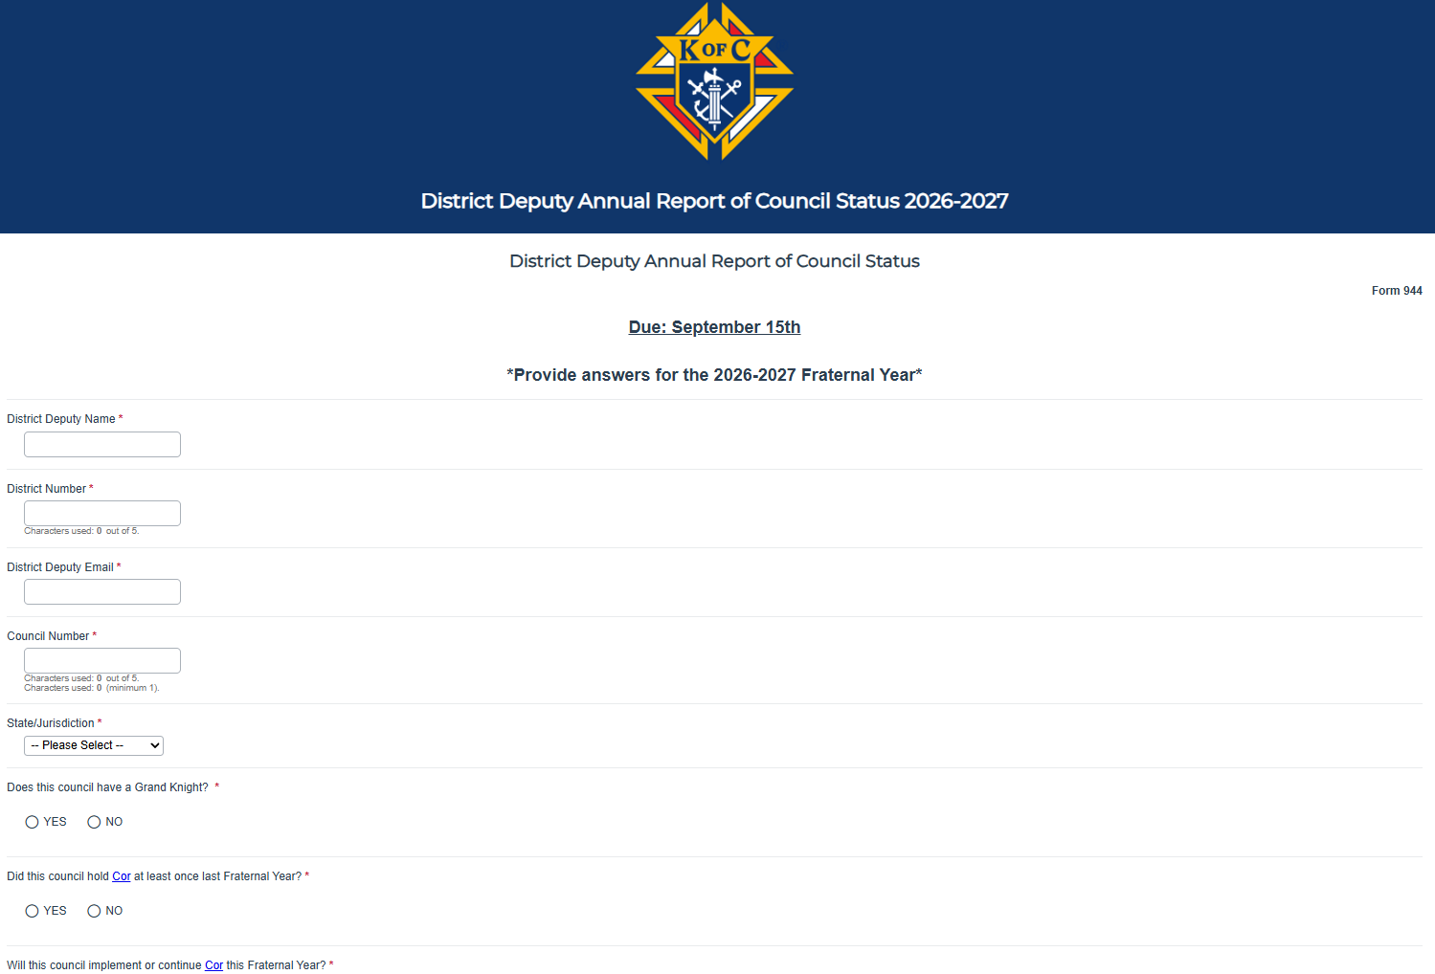
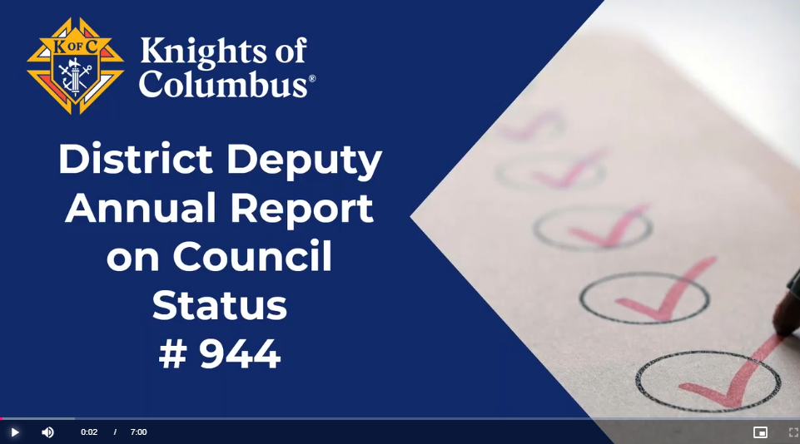
District Deputy Annual Report (#944)
www.kofc.org/forms

Slide 17

Exemplification of Charity, Unity, & Fraternity
Updated Instructions
  Invite local Fourth Degree leaders
  Honor Guard
  Invite Field Agent
    Added to speakers in the Closing Remarks

Slide 18
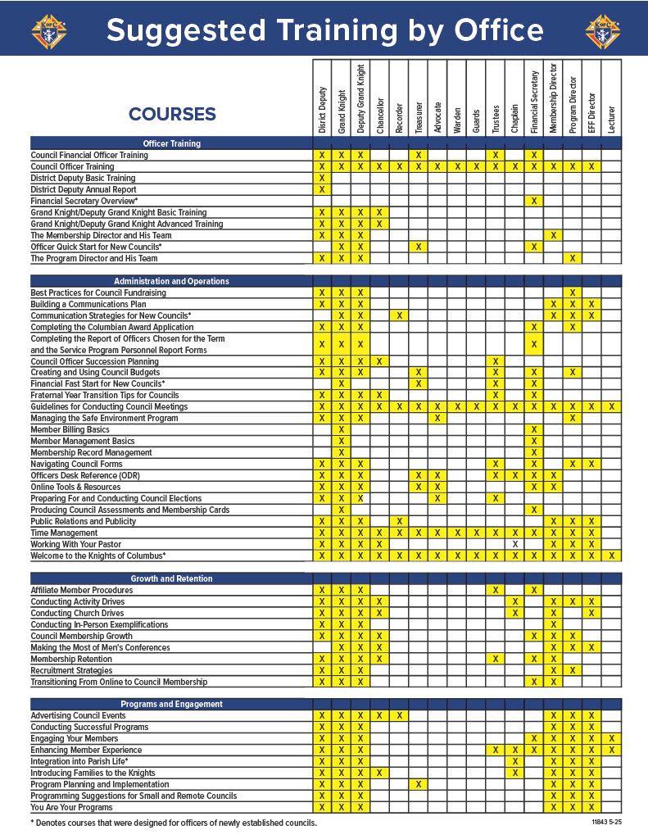
Suggested Training by Office Infographic
www.kofc.org/training

Slide 19
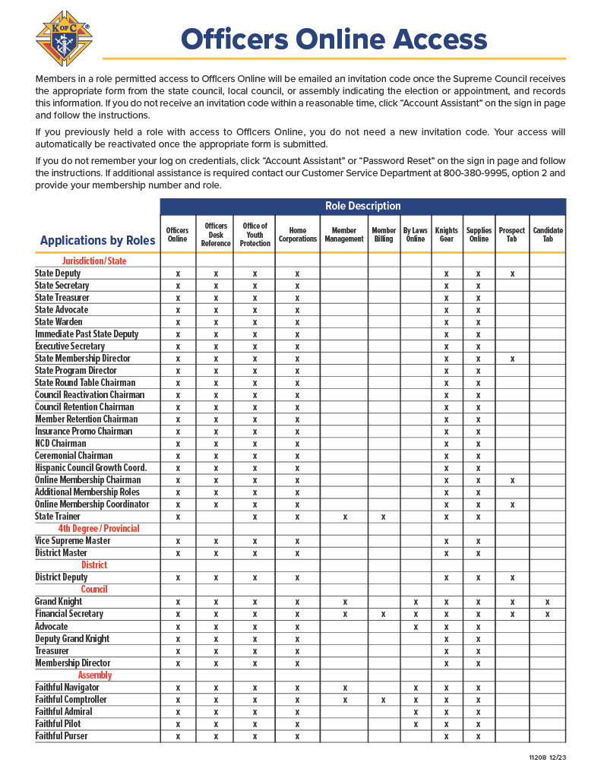
Officers Online Access Infographic
www.kofc.org/resources

Slide 20
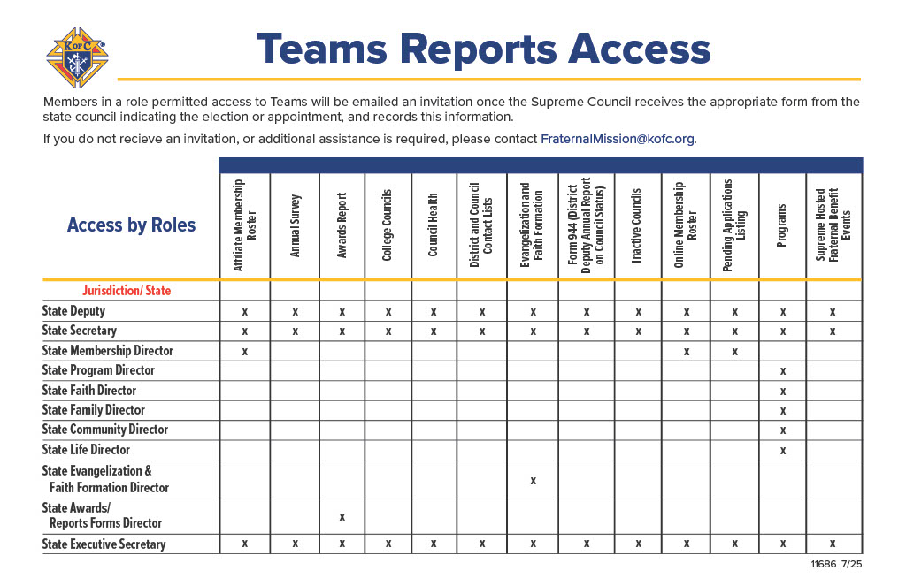
Teams Report Access Infographic
www.kofc.org/resources

Slide 21
Award Updates

Slide 22
Star District 2026 – 2027
Membership Growth (No Change)
  Attain 70% of combined council quotas
Insurance Promotion (No Change)
  At least 50% of assigned councils earn the Founders Award

Slide 23
Star District 2026 – 2027
Overall District Excellence
  At least two councils in the district earn the Star Council Award
    Districts with one council are not eligible
  Submit a District Deputy Annual Report on Council Status (#944) for each council in district by September 15
  Every council in district must submit forms #185 (officers), #365 (directors), 1728 (annual survey) and #1295 (annual audit)

Slide 24
Star Council 2026 – 2027
Earn the McGivney, Founders’, and Columbian Awards, and satisfy all administrative requirements
2026-2027 Administrative Requirements
Be in good standing with Supreme Council (pay assessments)
Safe Environment compliant (U.S. & Canada only)
Submit forms #185 (Report of Officers), #365 (Report of Directors), #1728 (Annual Survey)
NEW: Submit form #1295 (Annual Audit)

Slide 25
McGivney Award 2026 – 2027
NO CHANGES
Attain 6% intake growth based on July 1st council membership
Minimum 5 / Maximum 15

Slide 26
Founders’ Award 2026 – 2027
A number equal to 10% of Associate members on the July 1 council roster must meet individually with a field agent for a financial review
Minimum 5 / Maximum 15
To qualify, meetings must be with new or associate members

Slide 27
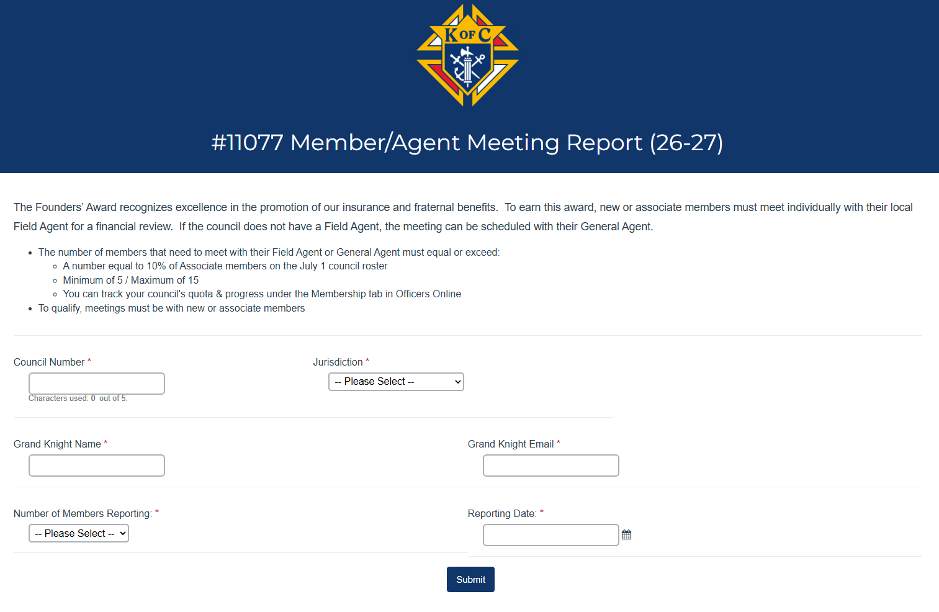

Slide 28
Old Columbian Award
Time-consuming
Confusing
Subjective
Quantity, not quality

Slide 29
New Columbian Award
Fast
Simple
Quality, not quantity

Slide 30
Requirement 1
Donate $500 toward any of the following:
    ASAP (cash or item value)
    Food for Families (cash or 1,000 lbs.)
    Coats for Kids
    RSVP

Slide 31
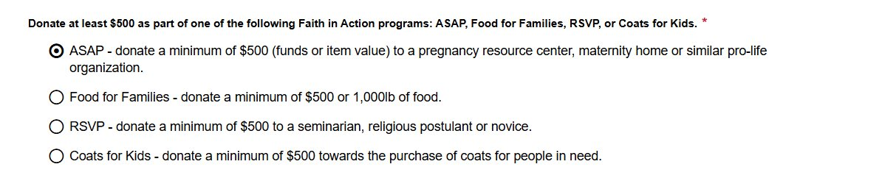

Slide 32
Requirement 2
Complete 4 programs
    1 per category (Faith, Family, Community, Life)

Slide 33
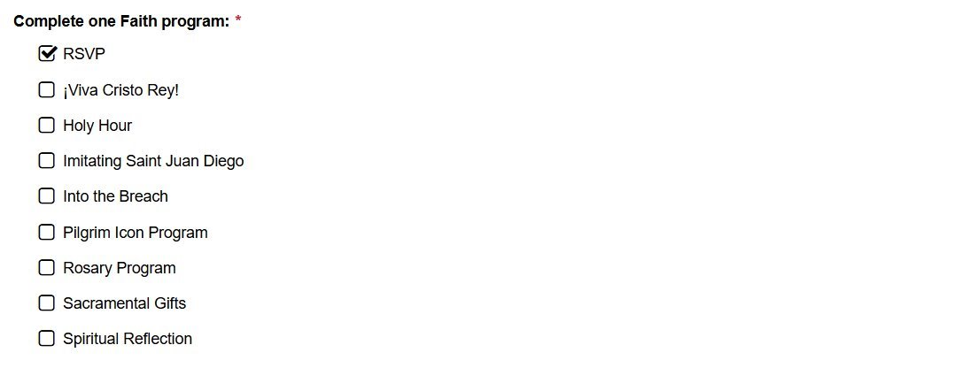

Slide 34
Requirement 3
Conduct Cor monthly
    Include name and email of EFF Director
OR
  3 unique programs/activities
    Build fraternity
    Bring men closer to Christ
    Serve parish or community

Slide 35
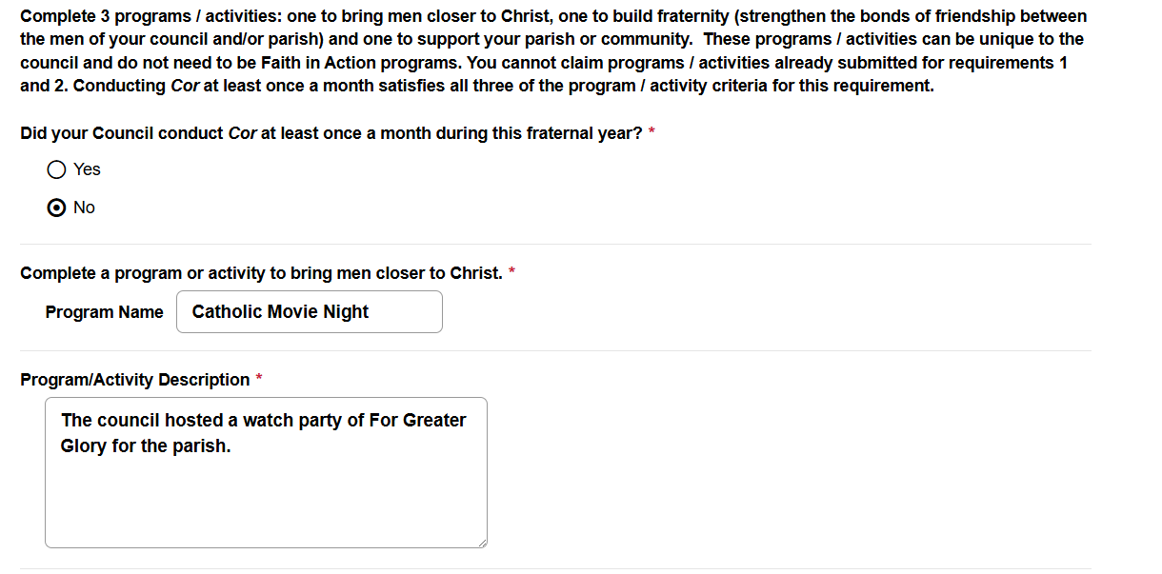

Slide 36
Columbian Award Outcomes
Improved processing
    Fewer applications denied
    Faster approvals
Mission alignment
    More council donations
    More Cor participants
    More fraternal events
Happier councils, more members

Slide 37
QUESTIONS?

