Slide 1


Slide 2
Teams – SharePoint
SharePoint center for data and report uploads
Most reports updated weekly
Used in partnership with Officer Online reports
Access is shared with a select audience (reported on State 365)
Role | Access
State Deputy | All Data
State Secretary | All Data
Membership Director | Membership Data
Program Director | Programs data
Faith Director | Programs data
Family Director | Programs data
Community Director | Programs data
Life Director | Programs data
EFF Director | Cor data
Awards/Reports Forms Director | Awards data

Slide 3

How to log in
Please do not use your mobile device!!
We recommend using a desktop or laptop for optimal user experience

Slide 4
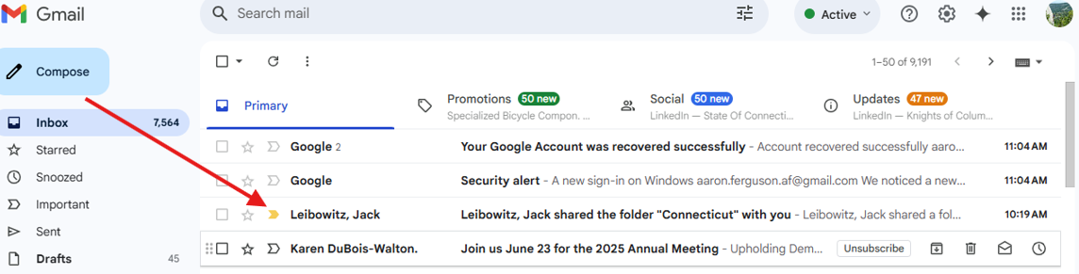
How to log in
You will receive a notification in your email from a KofC employee.

Slide 5
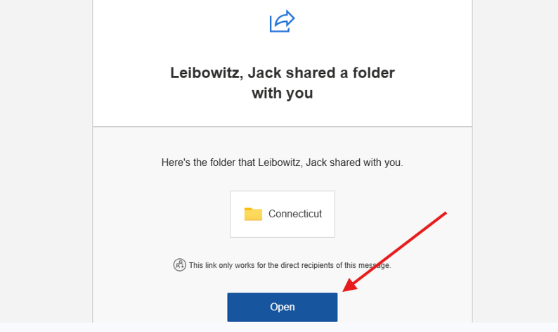
How to log in
Click to Open. SAVE THIS EMAIL!

Slide 6
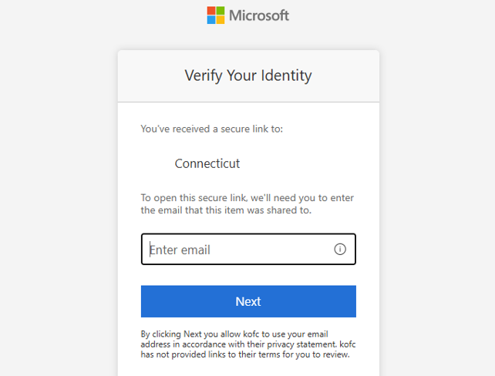
How to log in – Verify Identity
Enter the same email address that you received the invitation.

Slide 7
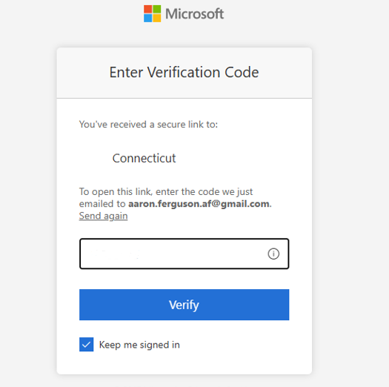
How to log in – Verify Identity
Where is my code?
Return to your inbox

Slide 8
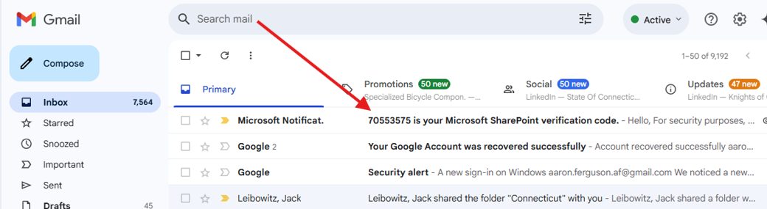
How to log in – Verify Identity
Copy your code from the Microsoft Email

Slide 9
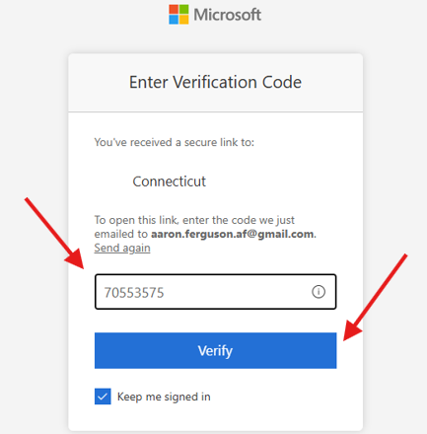
How to log in – Verify Identity
Paste your Code and press ‘Verify’

Slide 10
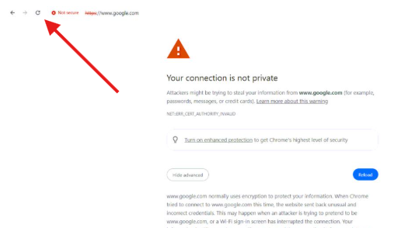
Possible Firewall Error – Just hit refresh

Slide 11
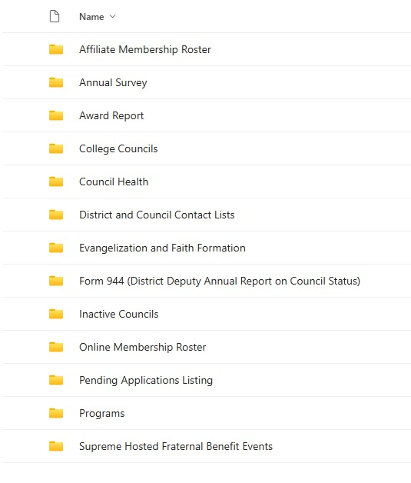
Teams - SharePoint
Affiliate Membership Data
Annual Survey Results
Council & District Award Progress
Council Health Data
Officer Contact Lists
Form 944 Submission and Summary
Online Membership Data
Programs Data
Supreme Hosted FBE Data

Slide 12
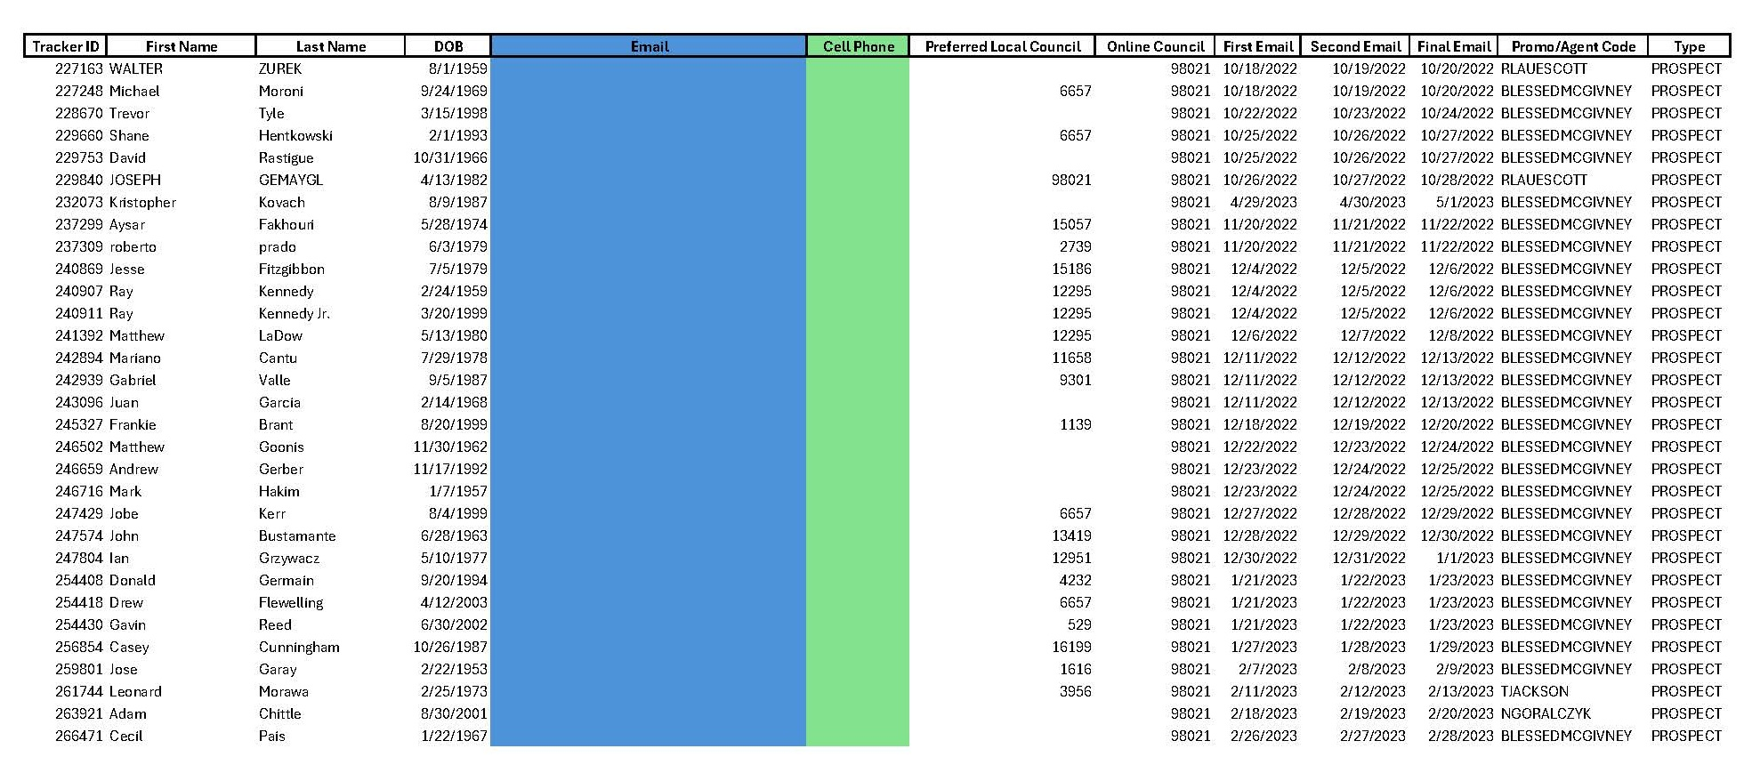
Pending Applications List

Slide 13
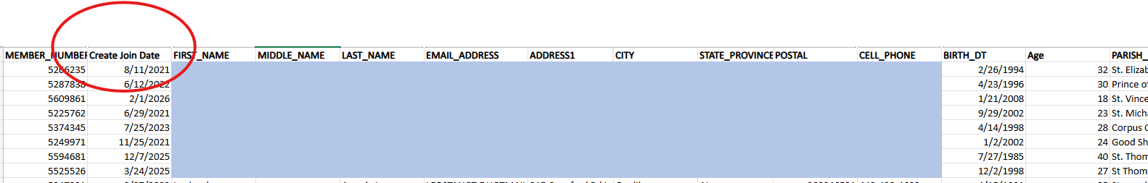
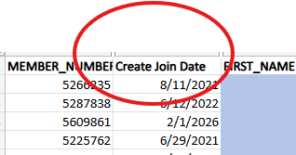
Online Roster and the 1 for 10 Incentive
For every ten (10) online members in your jurisdiction who take the Exemplification of Charity, Unity & Fraternity and transfer to a local council, we will reduce your Circle of Honor intake goal by one (1).
Must be from the current Fraternal Year.

Slide 14
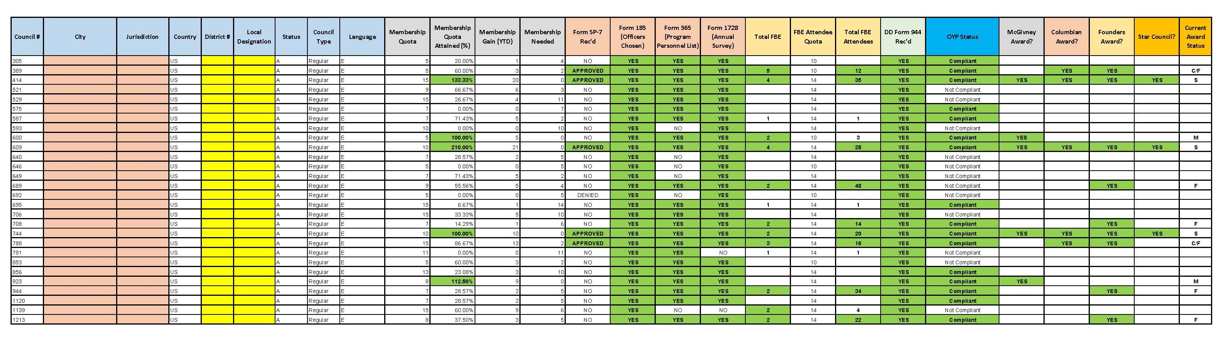
Council Star Award Progress Report

Slide 15
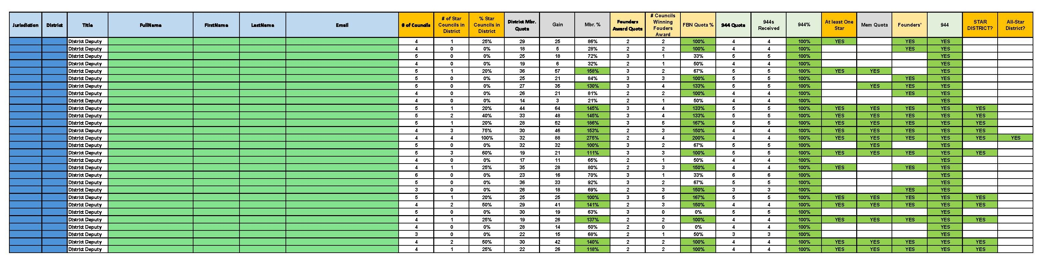
District Star Award Progress Report

Slide 16
Who to Contact
Trouble Logging into Officers Online?
    Customer Service (800) 380-9995
Submitting or Editing State 365
    FraternalMission@kofc.org
Emembership/Pending Application Updates
    Emembership@kofc.org
Trouble Logging In to Teams - SharePoint?
    FraternalMission@kofc.org

Slide 18

State Deputy 101: Cor & EFF
Notes:
Sean – Welcome, gratitude. Why are we doing this? Cor continues to grow.
Today, see the vison and know you have practical support.
Helping men encounter Christ while building sustainable local leadership.
To understand where we are headed, it helps to start with why Cor matters in the first place…

Slide 19
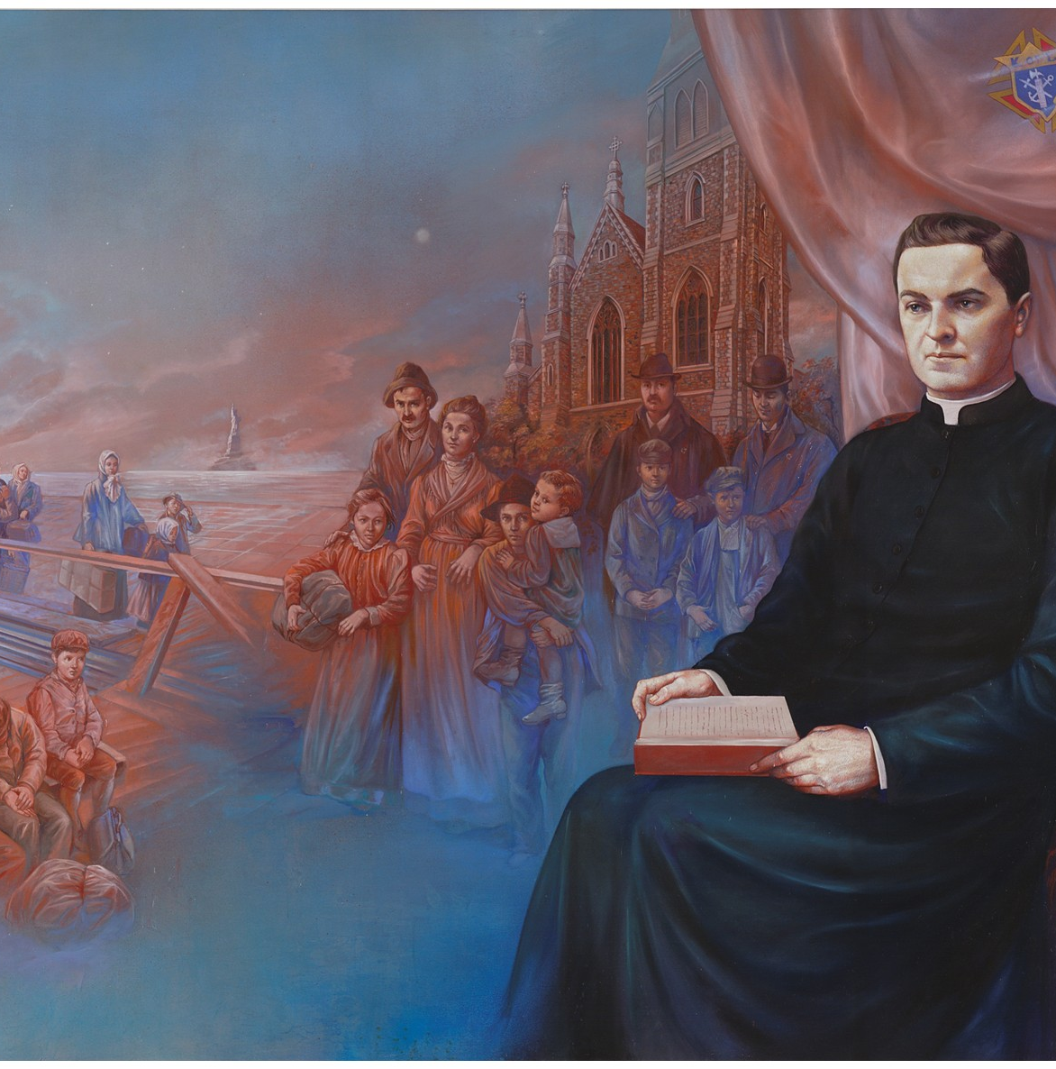
Cor Connection – Mission Narrative
Father McGivney had a clear mission:
    Form men in their faith
    Protect the family
  Is this mission relevant today?
Notes:
Sean
Men are hungry for authentic brotherhood; many councils lack spiritual depth even if there is plenty of activity happening there. Cor provides the opportunity for that fraternity, rooted in prayer and formation.
Is this still relevant? This connects us to the larger mission and vision of EFF…

Slide 20
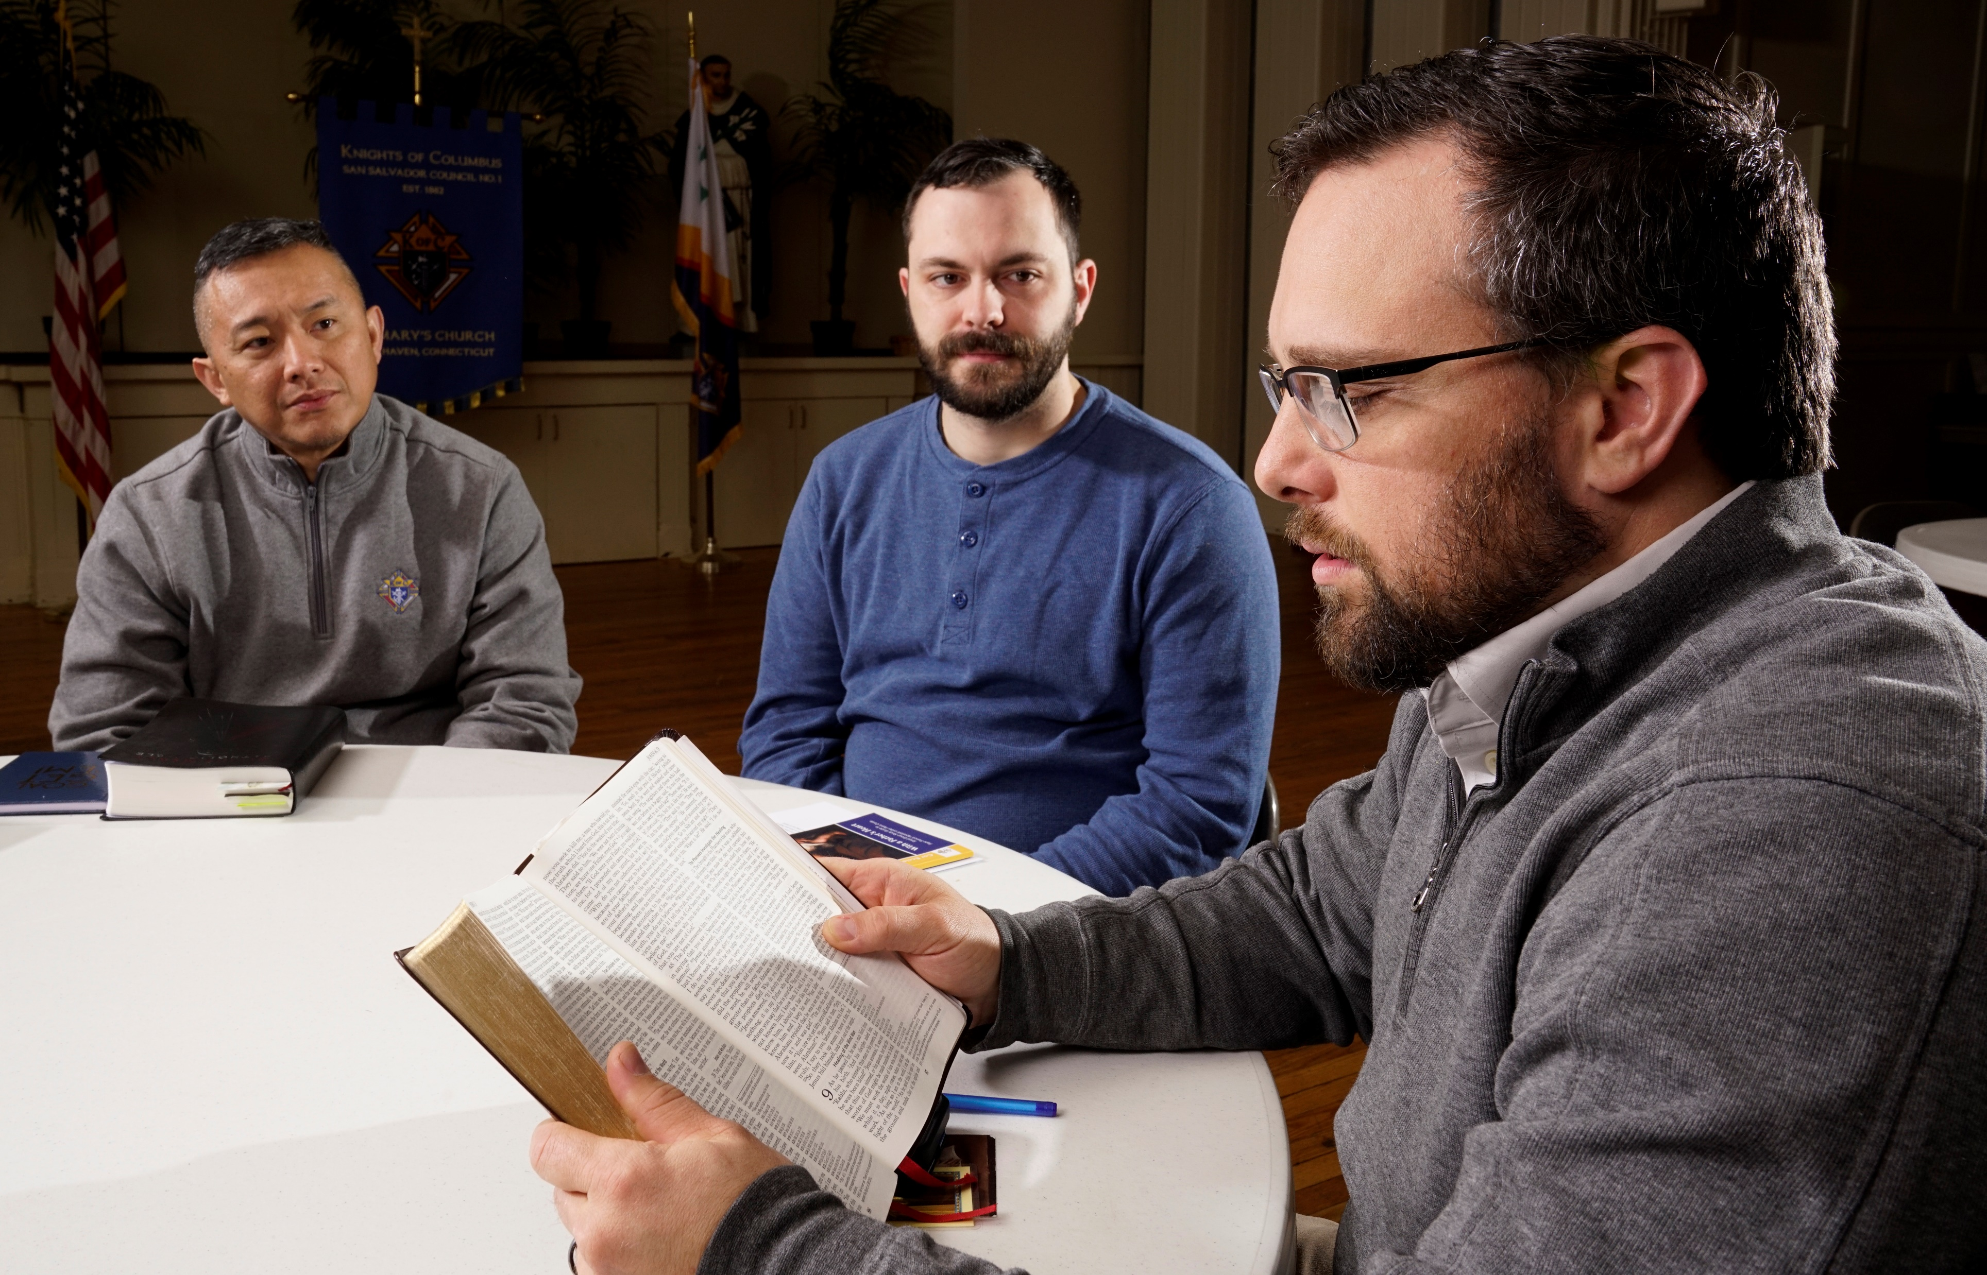
What is Cor ?
Cor is a regular gathering of men that uses a flexible framework of prayer, formation and fraternity to foster Christ-centered brotherhood and help men grow closer to Jesus.
Notes:
Lindsay – SDs, leaders, you can’t stress this connection enough to your jurisdictions that Cor upholds the vision of Blessed Father McGivney and the mission of the Knights. The essence of Cor is not new. It is simply us being more intentional about who you are as a Catholic fraternal order. The first step in adopting anything.. a product, an initiative, a cultural shift, is to understand WHAT IT IS. This is the LINE to take away today, to memorize, to promote and to champion throughout your jurisdiction. Every council should know the answer to What is Cor?
This one sentence answers key questions about Cor:
What is Cor at the simplest level? A regular gathering of men.
What is the structure? What do men do at these gatherings? Prayer, formation and fraternity
What is the purpose? To grow closer to one another (Christ-centered brotherhood) and to Jesus.
Again, this is the line to take up a little bit of brain space.

Slide 21
Mission and Vision
Mission:
To help focus men on Jesus by building Christ-centered brotherhood through a flexible framework of prayer, formation and fraternity.
Vision:
To aid in transforming the hearts of men through Christ-centered brotherhood. Rooted in prayer, formation and fraternity, men will be sharpened in faith and virtue as they cultivate authentic friendships with Christ and each other.
We envision a future where Cor continuously helps sustain men to lead their families, strengthen their parish communities and courageously evangelize the world as missionary disciples of Jesus Christ.
Notes:
Lindsay –
It is important to also share the mission and vision regularly, so everyone remains united and focused on the same purpose and direction. This is how cultural shifts happen, by being consistent on mission and vision.
Let’s focus on the 2nd part of the vision highlighted in YELLOW. Simply stated, the vision of Cor is help all men grow as missionary disciples.

Slide 22

Cor Success
Long Term
    Cor in every parish
    Prayer, formation, and fraternity for all men
  Short Term
    Appoint strong EFF leaders – Team
    Continue the cultural shift through awareness
    Study: Is Cor good for business?
Notes:
Raul – In light of that Vision statement…how do accomplish it?
Did Blessed Michael McGivney know KofC would be international?
Long Term – You’ve heard it said that every Catholic man should be invited to join the KofC…provide the space
Success Matters – Not everyone knows, advocacy, enthusiasm, zeal
Stronger men build stronger families
Stronger families build stronger councils
Stronger councils help strengthen the Church
Is Cor good for business?

Slide 23
State EFF Structure
Support Structure
    State EFF Director (appointed by you; State Deputy)
    Diocesan/Regional EFF Coordinators (chosen by the State EFF director)
    Council EFF Directors (appointed by the Grand Knight)
      EFF Director Form
  Clergy Support
    State Chaplain
      State Cor Clergy Liaison or Associate State Chaplain
    Diocesan Cor Clergy Liaison and/or Associate State Chaplain
    Local Pastors
Notes:
Raul – I just walked you through what Success looks like; Structure, not a selling point but necessary
You are not doing this alone; the practical methods of success can be measured with planning and the gathering of a “Dream Team”.
NOTE: CLERGY WILL NOT BE INVITED TO THE SEPT. EFF TRAINING. INSTEAD STATE EFF DIR. & 1 DIOCESAN EFF COORD.
Not moving away from pastor support, an intentional focus on training and succession planning

Slide 24
Supreme Support
  Annual State EFF Training
  Ongoing training and formation for directors and coordinators
      Training modules for State EFF Directors & Diocesan Coordinators
      Onboarding emails and training for Council EFF Directors
  State Deputies SharePoint: Evangelization and Faith Formation folder
  Communication
      Regional Calls
      Cor Newsletter
      SD Weekly / Fraternal Leaders Advisory
  Resources: www.kofc.org/cor & www.kofc.org/corleaders
Notes:
Josh
Save Training and Formation for next slide
- Sharepoint – EFF Folder – Resources, Data/reports, Org Meeting ‘26 Folder

Slide 25
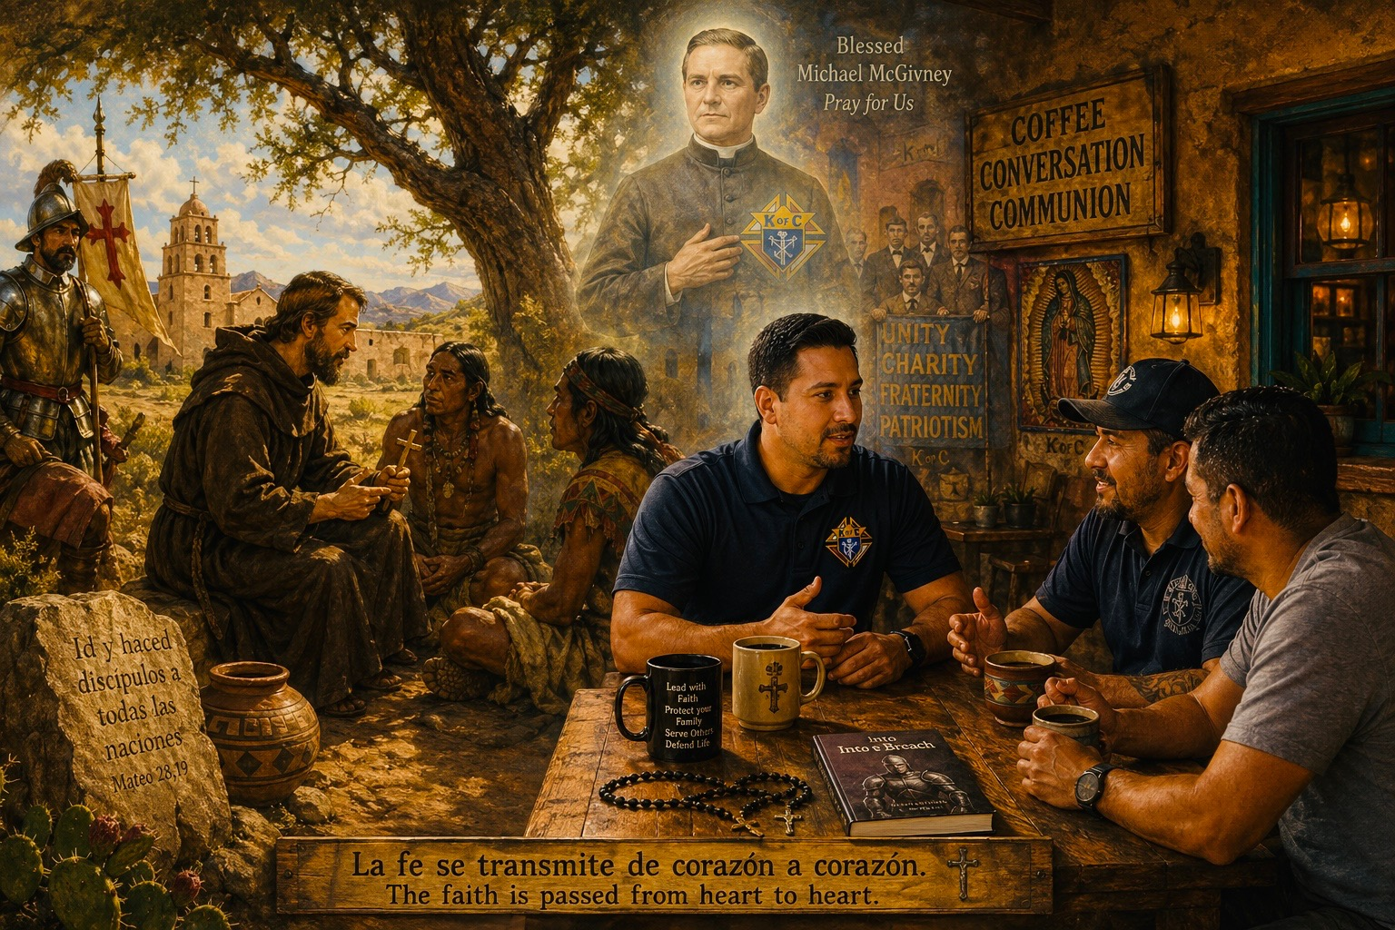
What’s New with EFF?
Leadership Training Modules
    Video and written components; state to diocesan to council
Heart of the Gospel
    The “retreat-in-a-box” for the men of the parish featuring Fr. Riccardo of ACTS XXIX; www.kofc.org/gospel
Cor being added to SP-7
    Track all council activity; Cor fulfills requirements
Notes:
Josh
Formation and skills
Formation in the Gospel
Not just programs

Slide 26

Cor Key Points
Intentional focus on building Christ-centered brotherhood
Council EFF Director runs Cor with pastor approval
GK appoints Council EFF Director; submits to Supreme via EFF Director Form
Supported by KofC & FORMED prayer and formation resources
Notes:
Lindsay –
Focus on Christ-centered brotherhood, not content consumption alone
Leadership structured for sustainability with Council EFF Director and his Cor team; this is not a GK burden
FORM is critical for EFF Director to receive Supreme communications and resources
There is no shortage of content to use in Cor between our ever-growing library of KofC resources and with our partnership with the Augustine Institute we also have access to all FORMED resources. All State Deputies, State Chaplains, State EFF Directors, and Council EFF Directors have free access to FORMED.

Slide 27
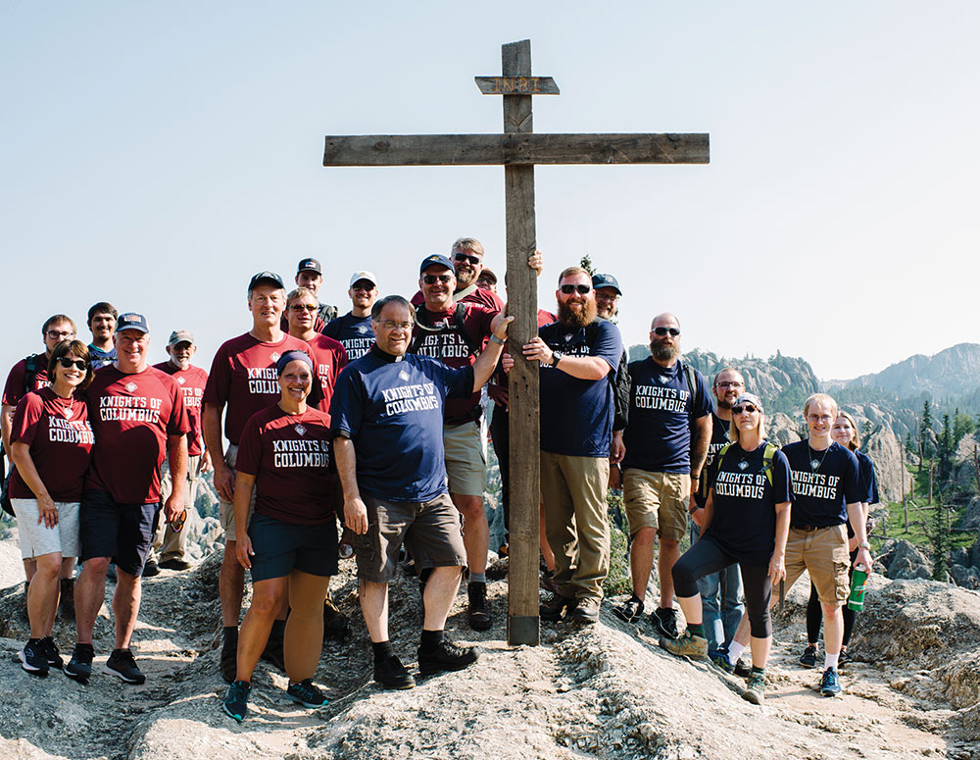
State Deputies Action Items
Appoint the right State EFF Director
    Meet with him soon
    Empower and endorse your EFF Director
    Suggested 2–5 year role
    Promote Council EFF Director Form
  Champion Cor personally
  EFF SharePoint data, and Resources
Notes:
Raul – Action Items: What, the vision and how to succeed; Here are some practical steps
Appoint: Form 365 forms have already been sent in. Good! Characteristics of a State EFF Director: able to build a team, be enthusiastic about EFF.
Meet Soon: validate his Role – make a blueprint/plan for this fraternal year. Help them to make EFF connections
Why suggested 2-5 year role?
Have you considered having your EFF Director do Cor at your organizational meeting? Work with your Growth Director on the agenda
Champion Cor –The men look up to you!… where do you attend Cor? your own Cor group, or with your State council; builds unity, trust; shared momentum for the mission
SharePoint: We wanted you to know the structure, support, and practical steps; we can complete with where to find

Slide 28
Where to Find Cor Resources
State Deputies SharePoint EFF Folder: Cor data by jurisdiction and Cor presentations
kofc.org/corleaders: PDFs of startup and promotional material
Supplies Online: GKs or FSs can order or download startup and promotional material
Shop Catholic Info: Click on Cor Resources to order Cor brochures and guides
Knights Gear: Click on Council/Cor to order Cor stickers, banners, tablecloth and soon other Cor merchandise (polos, t-shirts, button-downs, mugs)
.

Slide 29

Any Questions?

Slide 31

Expense Reimbursement Policy & Procedures
Notes:
Starting at the beginning with our title slides. There are four different options to choose from, the one you're seeing being the most commonly used. What we like about this one is the very prominent display of the emblem with a very large photo a big bold lettering. This slide also includes the date, which automatically updates to the current date. The text, photo, and date lines can all be modified.

Slide 32

Introduction & Objectives
  What is Reimbursable?
  Submission Process
  Documentation Requirements
  Approval & Reimbursement Timeline
  Forms & Templates
  Resources
Notes:
In 2020 the order updated its branding, part of that was creating a brand specific PowerPoint template. The fraternal operations department has worked with the template and refined it so it can be used to deliver our messages Across all departments with consistency in visual imagery, text, and color schemes.
We have not changed the design parameters of the PowerPoint template because it provide a lot of flexibility to work images and wording to deliver our message as effectively as possible.
This design template is meant for a wide screen broadcast. Please keep in mind, especially for staff, who may be using a host’s projector or TV, the ability to display in a wide screen format is required..
With the amount of flexibility built into this template there is no need to alter change or create something new. keeping in line with that first bullet point our goal here is to create consistency with how we are presenting our message to our members and business partners.
One thing that we do not go into detail in this presentation, but I would like to mention now is the use of animations. PowerPoint has several animations and slide transitions that can be incorporated to enhance the delivery of a presentation. However, not all animation and transitions have professional appeal. If animations are a part of the presentation you are creating, we ask you to please use the ‘appear’ animation

Slide 33

What is Reimbursable?
  State Deputy Expenses:
  Mileage
  Hotel Room
  SD Meals
  District Deputy Expenses:
  Mileage
  Org. & Mid-Year Meetings
Notes:
The next is a layout forms the body of your presentation and there are 10 options to choose from. In this option we have a large picture on 1/2 and supporting text on the other. With this layout you can adjust the size of the picture or the text box to make one more prominent than the other. The text box has different layers for main points, bullets and indenting. Not every content slide needs to have a picture or graphic, but they are a strong visual aid in presenting a message. It is easy to get carried away with images. Simply insert a picture for the sake of having an image is a poor use of images and can have a negative impact on the delivery. it is OK to have a content slide with just text.

Slide 34

Not Reimbursable?
  Examples include:
  Postage
  Meals for others
  Excessive meals & social events
  Alcohol
  Spousal travel expenses
  State convention expenses
  Travel outside of jurisdiction
Notes:
The next is a layout forms the body of your presentation and there are 10 options to choose from. In this option we have a large picture on 1/2 and supporting text on the other. With this layout you can adjust the size of the picture or the text box to make one more prominent than the other. The text box has different layers for main points, bullets and indenting. Not every content slide needs to have a picture or graphic, but they are a strong visual aid in presenting a message. It is easy to get carried away with images. Simply insert a picture for the sake of having an image is a poor use of images and can have a negative impact on the delivery. it is OK to have a content slide with just text.

Slide 35

Submission Process
    Types of Expenses to Submit:
  State Deputy
  District Deputies
Org. & Mid-Year Meetings
Notes:
The next is a layout forms the body of your presentation and there are 10 options to choose from. In this option we have a large picture on 1/2 and supporting text on the other. With this layout you can adjust the size of the picture or the text box to make one more prominent than the other. The text box has different layers for main points, bullets and indenting. Not every content slide needs to have a picture or graphic, but they are a strong visual aid in presenting a message. It is easy to get carried away with images. Simply insert a picture for the sake of having an image is a poor use of images and can have a negative impact on the delivery. it is OK to have a content slide with just text.

Slide 36

Submit Request
  Send all expenses to: FraternalLeaderExpenses@kofc.org
  SDs: submit every 30 Days
  DDs: submit every 3 months
  Meetings: submit within 30 days
Notes:
The next is a layout forms the body of your presentation and there are 10 options to choose from. In this option we have a large picture on 1/2 and supporting text on the other. With this layout you can adjust the size of the picture or the text box to make one more prominent than the other. The text box has different layers for main points, bullets and indenting. Not every content slide needs to have a picture or graphic, but they are a strong visual aid in presenting a message. It is easy to get carried away with images. Simply insert a picture for the sake of having an image is a poor use of images and can have a negative impact on the delivery. it is OK to have a content slide with just text.

Slide 37

Documentation Requirements
  Itemized Receipts for All Expenses
  Hotels
  Meals
Notes:
The next is a layout forms the body of your presentation and there are 10 options to choose from. In this option we have a large picture on 1/2 and supporting text on the other. With this layout you can adjust the size of the picture or the text box to make one more prominent than the other. The text box has different layers for main points, bullets and indenting. Not every content slide needs to have a picture or graphic, but they are a strong visual aid in presenting a message. It is easy to get carried away with images. Simply insert a picture for the sake of having an image is a poor use of images and can have a negative impact on the delivery. it is OK to have a content slide with just text.

Slide 38

State Meeting Template Overview
  Include:
  DD Information
  Hotel Room Receipts
  Event Meal Receipts
  Sign-in Sheet for Wives
  Avoid Ineligible Costs:
  Equipment, conference rooms, guests
Notes:
The next is a layout forms the body of your presentation and there are 10 options to choose from. In this option we have a large picture on 1/2 and supporting text on the other. With this layout you can adjust the size of the picture or the text box to make one more prominent than the other. The text box has different layers for main points, bullets and indenting. Not every content slide needs to have a picture or graphic, but they are a strong visual aid in presenting a message. It is easy to get carried away with images. Simply insert a picture for the sake of having an image is a poor use of images and can have a negative impact on the delivery. it is OK to have a content slide with just text.

Slide 39

Approval & Timeline
  Requests = First in, First Out
  State Deputies:
    Priority over DDs
    Direct Deposit = Received within 10 Business Days
  District Deputies:
    Check = Sent within 10 Business Days
Notes:
The next is a layout forms the body of your presentation and there are 10 options to choose from. In this option we have a large picture on 1/2 and supporting text on the other. With this layout you can adjust the size of the picture or the text box to make one more prominent than the other. The text box has different layers for main points, bullets and indenting. Not every content slide needs to have a picture or graphic, but they are a strong visual aid in presenting a message. It is easy to get carried away with images. Simply insert a picture for the sake of having an image is a poor use of images and can have a negative impact on the delivery. it is OK to have a content slide with just text.

Slide 40

Resources
  Charter Constitution & Laws
    Kofc.org/ccl (PDF Download)
  Expense Reimbursement Forms
    Kofc.org/forms
  State Deputy Handbook
    Kofc.org/training
Notes:
The next is a layout forms the body of your presentation and there are 10 options to choose from. In this option we have a large picture on 1/2 and supporting text on the other. With this layout you can adjust the size of the picture or the text box to make one more prominent than the other. The text box has different layers for main points, bullets and indenting. Not every content slide needs to have a picture or graphic, but they are a strong visual aid in presenting a message. It is easy to get carried away with images. Simply insert a picture for the sake of having an image is a poor use of images and can have a negative impact on the delivery. it is OK to have a content slide with just text.

Slide 41

Key Takeaways
  Follow Directions for Accurate & Timely Reimbursement
  State Deputy Involvement is Critical to a Successful Process
  Ask Questions – We’re Here to Help!
  FraternalLeaderExpenses@kofc.org
Notes:
The next is a layout forms the body of your presentation and there are 10 options to choose from. In this option we have a large picture on 1/2 and supporting text on the other. With this layout you can adjust the size of the picture or the text box to make one more prominent than the other. The text box has different layers for main points, bullets and indenting. Not every content slide needs to have a picture or graphic, but they are a strong visual aid in presenting a message. It is easy to get carried away with images. Simply insert a picture for the sake of having an image is a poor use of images and can have a negative impact on the delivery. it is OK to have a content slide with just text.

Slide 42
Thank you!
Vivat Jesus!
Notes:
Thank you for viewing this session and helping us to create consistency across the KofC Brand.

Slide 45
KofC Leadership Formation
Joe McInerney, PhD. Senior Vice President of Leadership Formation
Mike Phelan, Director of Fraternal Leadership Formation
Ali Ghaffari, Leadership Development Education Specialist

Slide 46
The McGivney Fellowship
Forming Apostolic Leaders
In Christ-Centered, Virtue-Based Leadership
2-Year Program
www.kofc.org/mcgivneyfellowship

Slide 47
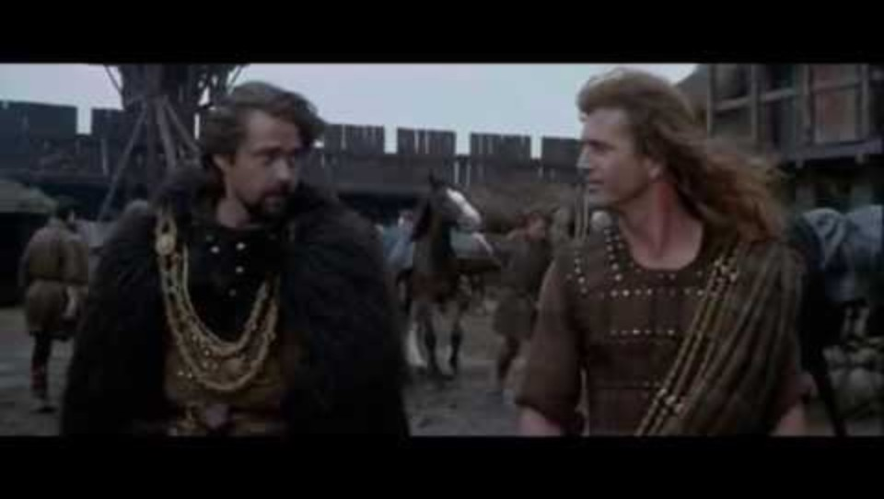
“Men don’t follow titles; they follow courage.”

Slide 48
Principle: Why Virtue?
An Ancient Roman Leadership Distinction
Potestas
“Position/Title”
Signified place in hierarchy
Gave a certain accepted authority
Auctoritas
“Authority”
Based on character, virtue, true relationships
Spiritual power of influence

Slide 49
Where do we see auctoritas at work…
In a family?
In a council?
In a state team?
*A leader’s growth in virtue, it can be said, is the most fundamental and practical positive factor in his leadership effectiveness.

Slide 50


KofC COACHING TRAINING
ORIENTATION

Slide 51

Knights Coaching Program Details
What? Training in Coaching
So What? Coach Future State Deputies
Learn a new skillset to increase your capacity to build into others
As able, coach up and coming State-level leaders
Who? Past State Deputies
When? Fall
Six-week program offered in the Fall, one meeting/week, assigned coachee
Continue to utilize your experience and gifts to serve the Order

Slide 52
KEY SKILL TAUGHT IN THE PROGRAM
Learn Basic Skills
Create and Execute a Plan
Listening, Asking Powerful Questions
Practice, Practice, Practice
Introduction
Gather Data
Transition
Learn what coaching is
Collecting data, setting goals, creating a plan
Preparing your coachee for success

Slide 53
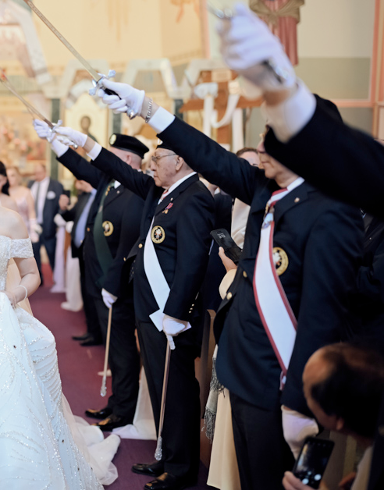
COACHING DEFINED
Coaching is:
  Partnering with your coachee in a thought-provoking and creative process that inspires them to maximize their personal and professional potential.

Slide 54
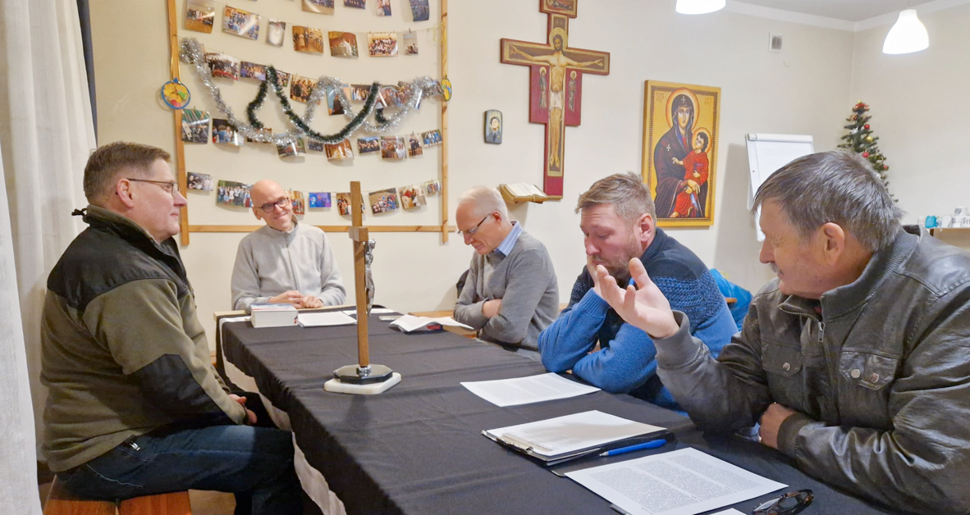
PURPOSEFUL CONVERSATIONS
  Coachee starts with a goal
  Coach asks thought-provoking questions to expand possibilities and solutions
  Leads to action and improved results
  Challenges and supports coachee to reach their full potential
FOCUSED ON GOALS

Slide 55

Coaching Demo

Slide 56
BENEFITS OF COACHING
Motivate and Inspire
Increase Engagement
Develop Potential
Improve Results
Most people have a desire to become a better version of themselves - you can help them.
When people feel invested in, they give more to the organization that is investing in them.
Oftentimes, leaders don’t get many opportunities to continue to grow and develop their potential
A leader with a coach performs better than one without.

