Slide 1
Evangelization and Faith Formation
Jonathan Reyes
Senior Vice President for Evangelization and Faith Formation

Slide 2
Evangelization and Faith Formation
“Today is a providential opportunity for each of us to decide what is our next step in achieving an ordered life in Christ. This is not a time for half-measures. There are no part time disciples.... It is all or nothing.”
– Supreme Knight Carl A. Anderson

Slide 3
Evangelization and Faith Formation
Our Vision
The Crisis – A failure to evangelize
Our Response
  Formation – strengthening our Catholic life
  Evangelization – presenting the Faith in a convincing way through our words and actions

Slide 4
Evangelization and Faith Formation
“In a divided world, where many find it difficult to truly encounter God, Knights of Columbus families live their faith, fulfill their mission, and evangelize the world.”
– Exemplification of Charity, Unity and Fraternity
Building the Domestic Church – the family
  The link between faith and families
Faith in Action

Slide 5
Evangelization and Faith Formation
Activities
  Programs
  Content – Catholic Information Service
Our team

Slide 6
We Are Knights
Our witness to the broader Church
  “Really, the Knights do all that?!”
  A beacon of light

Slide 7
Our Programs – Our Witness
“Come and See”
  A witness to two loves: Love of God and Love of Neighbor
Importance of our programs

Slide 8
Faith in Action Programs
Year three for Faith in Action
Faith in Action adoption and council health
Tools to succeed:
  Prayer
  Leadership
  Planning
  Reporting

Slide 9
Faith in Action Programs
Leadership
Choose the right person for the job
Provide role clarity – encourage delegation
    Program Director Role Description
Support
    Program Team Communication Channels

Slide 10
Faith in Action Programs
Planning
Working With Your Pastor Guide
    Found on kofc.org in For Members section
Intentionally select programs
    RTD Training – You Are Your Programs (in development)
Plan in advance
Consider all stakeholders

Slide 11
Faith in Action Programs
Reporting
Benefits of accurate real-time information
Online reporting
Regular reporting

Slide 12
Faith in Action Programs
Columbian Award
Simplified
Key changes
  No more required programs
  Four featured programs per category (two credits each)

Slide 13
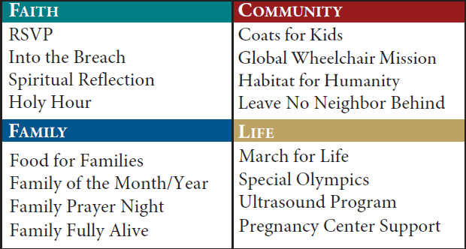
Faith in Action Programs
Featured Programs

Slide 14
Faith in Action Programs
We are here to help
Renewed Resources – kofc.org/fiaresources
  Updated Faith in Action Guidebook
  Simplified program guide sheets
  Website – English, Spanish, and French
  Program director role descriptions
  Communication channels
We want your feedback

Slide 15
Into the Breach: Video Series
A Clarion Call
“Men, do not hesitate to engage in the battle that is raging around you…”
“Not only does God have a plan for your life, so does Satan.”
– Bishop Thomas J. Olmsted

Slide 16
Into the Breach: Video Series
Program Launch
Into the Breach video series will be launching as a Faith in Action program in July 2020
Every council is asked to undertake this program, which will be a major priority for the new Fraternal Year
Into the Breach study guide will soon be an available resource
All episodes are available on kofc.org/intothebreach

Slide 17
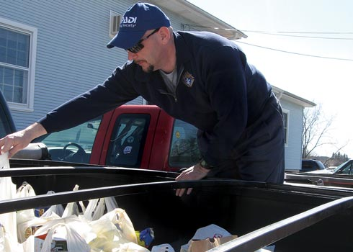
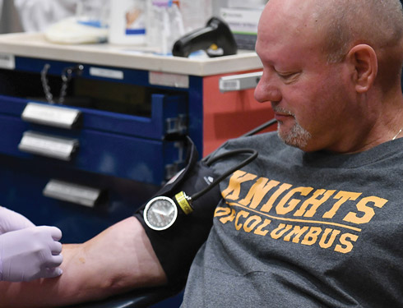
Leave No Neighbor Behind

Slide 18
Evangelization and Faith Formation
“In a divided world, where many find it difficult to truly encounter God, Knights of Columbus families live their faith, fulfill their mission, and evangelize the world.”
– Exemplification of Charity, Unity and Fraternity

