Slide 1
Insurance Promotion
Robert S. Marlowe, Jr., CLU, FICF, LUTCF
Sr. Vice-President Agencies and Marketing
June 2020

Slide 2
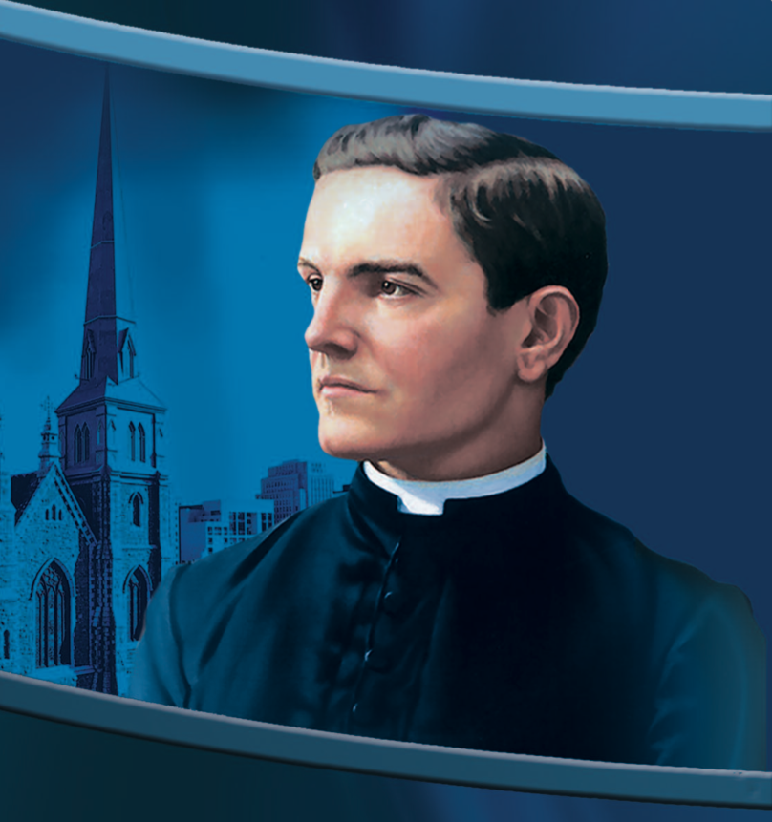
Fr. McGivney’s Vision
Bring Catholic men together to strengthen their faith, and help them become better Catholics, better men, better husbands and better fathers.
Protect these Catholic families from the financial perils of death and disability so the family unit can stay in place.

Slide 3

Fraternal-Insurance Partnership
Our goals are in alignment...
…but we do have different roles.
Recruiting is a shared responsibility.

Slide 4
A Great Time to Be a K of C Leader
This health crisis has left people searching for meaning in their lives and answers to today’s problems.
They’re feeling that loss of community, and – in some cases – the absence of faith.
Our Order offers men a community and an example of how to live their faith.
We have a rare opportunity right now to reach out to all Catholic men to share the gift of membership

Slide 5
The Membership-Insurance Connection
Knights provide and protect. When a man joins, he embraces that responsibility in a new way.
Our insurance offerings provide an avenue for that too.
A new member who participates in our insurance program is a more well-rounded member, who sees this connection and understand the full scope of our mission.

Slide 6
The Membership-Insurance Connection
A member who buys K of C insurance does so for more than just buying a financial product…
…his purchase makes a statement and makes a difference. He’s putting his money where his mouth is.
He knows that our insurance program is the engine that drives our Order’s charitable programs.
He buys because he’s pro-life, he’s pro-family, he understand that his premium dollars are going to an organization that shares his Catholic values.

Slide 7
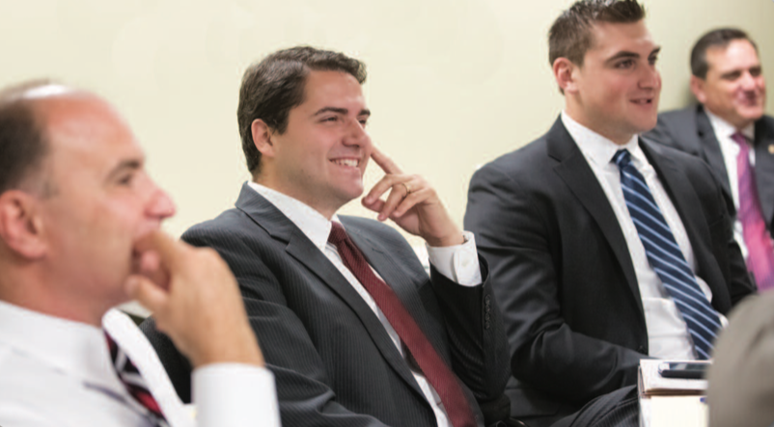
How Can We Help?
Recruiting drives
New Council Development
Retention of delinquent members
Council connectivity with your membership base
Our agents are sales professionals – perfect for membership recruiting!

Slide 8

How Can We Help?
Your field agents know your members best.
They may have better contact info.
They may know situations of need or distress.
They know prospective members.
Let’s collaborate!

Slide 9
How Can You Help Us?
Invite your General Agent(s) to all of your state meetings.
Invite him to sit in the front of the room with the other dignitaries.
Give him a chance to speak at each meeting.
Don’t worry about trying to sell insurance. That’s our job. Just highlight the trust and respect you have for your General Agent and his Field Agents.
Get creative! Can agents be ushers? Can they be part of convention registration? Include them in social functions. Ask them to host a hospitality room.

Slide 10
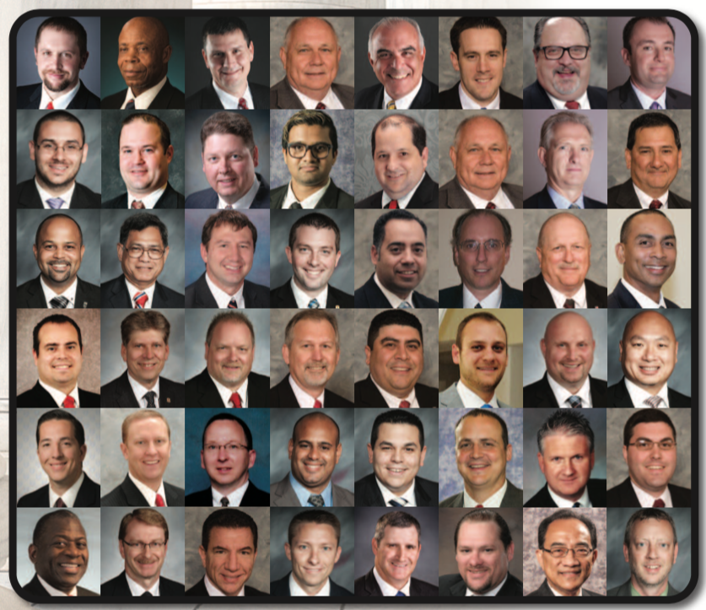
Successful Council/Field Agent Tips
Invite agents to sit at the front.
Include him in all council communications and social media.
Make sure he’s aware of all membership activity, gains and losses.
Promote fraternal benefits nights.

Slide 11
Fraternal Benefits Nights
FBNs are great council activities that bring members and families together.
They also help tell the K of C story to the broader parish community.
Agents can present on: K of C offerings, long term care, retirement planning, estate planning, charitable giving, special needs planning, social security choice options, and legacy planning.
Agents can also invite guest hosts, such as a: long term care facility representative, attorney, funeral director, Social Security representative, or CPA.

Slide 12
You’re the Leader, We’re Your Team
You need to communicate your vision.
You need a strong leadership team.
You need to keep volunteers motivated.
Let us be partners! Our Field Agents have your best interests at heart.
We want you to be successful! We share your membership goals!
Your general agents have a team of men ready to help.

Slide 13
Online Membership: A Critical Tool
It’s an easier way to introduce men to the Knights.
It’s the answer to the man who says “I’m too busy, but I love what the Knights stands for.”
It’s a feeder system for our councils.

Slide 14
Responding to the Health Crisis
We’ve gone virtual too.
Agent are leveraging Skype for Business, and it’s proving to be a great solution that members are enjoying.
Our sales have only seen a slight impact – which is a testament to our members, our business model and our agents.
Out of crisis will come change. This will change our model for the better.

Slide 15
The Strength of Our Foundation
Fortune 800
Tied for most financially strong life insurer in North America…
…all thanks to our members and our model.
We treat every single interaction with a brother Knight and his family with care, respect and professionalism.
We see their situation through their eyes, only making recommendations that we would want if that were our situation.

Slide 16
Together As One
Call your agents.
Engage with them.
Communications is key to keeping people together.
We value your feedback and look forward to a successful partnership with you.
Thank you for the leadership role you have undertaken!
We appreciate your commitment to the Order, and our mission to recruit men so they may grown in their faith and service to our Church and their communities.

