Slide 1
Office of the Supreme Advocate
Office of Youth Protection
John Marrella
Supreme Advocate/General Counsel
Knights of Columbus
June 6, 2020
New Haven, CT

Slide 2
Council Governance
Excellence Team

Slide 3
Council Governance Excellence Team
Council Governance Excellence Team
Dedicated and experienced customer service team of attorneys and paralegals
Assists key leaders in addressing council governance and membership challenges
Contact at 203.752.4017 or council.handbook@kofc.org
Council/Home Corporation Relationships
Brand Management
Tax EIN
Liability Insurance
Finances / Investments
By-Laws
Disputes/Litigation
Gaming/Liquor Licensing
Practical Catholic Membership Issues
Privacy

Slide 4
Form 990 IRS Annual Filing Requirement

Slide 5
The Basics
IRS Filing Requirement
The Internal Revenue Service (IRS) requires the Knights of Columbus and all of its subordinate councils, assemblies, and chapters in the United States (collectively referred to as councils) to file an annual informational tax return (IRS Form 990, 990EZ, or 990N).
Each council must obtain an Employer Identification Number (EIN) from the IRS and then register it with the Supreme Advocate’s Office.
Once a council obtains an EIN, the Supreme Advocate’s Office will notify the IRS of the council’s affiliation with Supreme so that the council can be granted tax-exempt status.
A step-by-step guide on how to apply for an EIN is located under the Tax Issues tab of the Officers’ Desk Reference.

Slide 6
The Basics
What are the Annual Filing Requirements
All councils in the United States must file an annual Form 990, regardless of income.
Most councils will file a Form 990N (e-Postcard). Form 990N filers have annual gross receipts of $50,000 or less and total assets of $250,000 or less.
Filings are done on a calendar year or fraternal year. A new council’s first filing will determine its filing year.
If a council does not file a Form 990 for three consecutive years, the IRS will revoke its tax-exempt status. In order to reinstate its tax-exempt status, the IRS requires the council to pay a fee of $600.
Additional details, as well as a step-by-step guide on how to file your council’s Form 990, are located under the Tax Issues tab of the Officers Desk Reference.

Slide 7
FAQs
Q: Is my council a charity recognized under Section 501(c)(3) of the Internal Revenue Code (IRC)?
  A: No. The Knights of Columbus is recognized as a tax-exempt Fraternal Beneficiary Society under Section 501(c)(8) of the IRC. All subordinate councils in the United States are eligible for this exemption. The Supreme Council and some state councils have set up charitable corporations that are recognized under 501 (c)(3).
  Q: Are donations to Knights of Columbus councils deductible on the donor’s income tax return?
  A: No. Donations to Knights of Columbus councils are not ordinarily deductible, though there are narrow exceptions to this rule (explained further on the Officers’ Desk Reference).
Q: If Knights of Columbus Councils are considered tax exempt, does that mean we don’t have to pay sales tax when purchasing food or other council supplies?
  A: No. Generally, state legislatures grant state sales tax exemptions only to charitable organizations that are recognized by the IRS under section 501(c)(3).

Slide 8
We are Here to Help
Information on the annual filing requirement, along with many other helpful topics affecting your council, may be found on the Officers’ Desk Reference, which is accessed through the Officers Online Portal. To obtain a user name and password to the Officers Online Portal, please contact Customer Service at 1-800-380-9995.
Every January, the Supreme Advocate’s Office sends out an annual Tax Memo, which provides detailed guidance for Financial Secretaries and other state and local council officers.
If you have questions regarding your council’s annual filing requirement, please contact us by e-mail at tax.ein@kofc.org or call Ann Petrillo, Council Tax Facilitator, at 203-752-4559.

Slide 9
Office of Youth Protection

Slide 10
Office of Youth Protection
kofc.org/safe
Office of Youth Protection
Leads our initiative to protect children and other vulnerable persons we serve
Maintains vigilance for signs of abuse
Office of Youth Protection:
203.752.4558 or oyp@kofc.org
Member Helpline:
203.800.4940 or youthleader@kofc.org
Suspect Abuse? 1.844.563.2723
Assists key leaders in complying with the requirements of our safe environment
Addresses key safe environment challenges
safeguards children and other vulnerable persons
Assures members and their families that we maintain a safe environment for all we serve
Protects members from awkward situations, misunderstandings and appearances of impropriety
Builds trust with the dioceses and parishes
Protects the good narne of the Knights of Columbus
Assists in winding down Columbian Squires Program

Slide 11
Safe Environment Program

Slide 12
Safe Environment Program
Local Council’s Step by Step
How-to-Guide
Knights of Columbus - Fraternal Excellence / Office of Youth Protection

Slide 13

Complete and Submit Forms 185 and 365
BEST RESULTS: Submit Completed Form 185 (Officers) and Form 365 (Directors) Online via Member Management
Safe Environment Program
KEY LEADERS / REQUIRED ROLES
Grand Knight – training
Program Director – training
Family Director – training; background check
Community Director – training; background check
Forms 185 and 365 Data
  Uploaded to Ingenium via Member Management
  Transmitted from Ingenium to Praesidium on Thursdays
Note: To attain Star Council –
All required roles must be filled by 6/15/2020 as the last date that Praesidium will be emailing members their requirements is Monday, 6/22/2020.
Appointed members then have until Monday, 6/29/2020 at 4:00 pm EST to complete all requirements.

Slide 14
Email from Praesidium On MONDAY
On Monday, Praesidium sends email(s) to newly appointed members
  One Email For Training ONLY (Grand Knight; Program Director)
    Email #1: Training Username and Password
  Two Emails For Training AND Background Check (Community/Family Directors)
    Email #1: Training Username and Password
    Email #2: Background Authorization/Consent
  Emails are sent WEEKLY from Praesidium until member is compliant OR removed because of noncompliance (after 30 days)

Slide 15
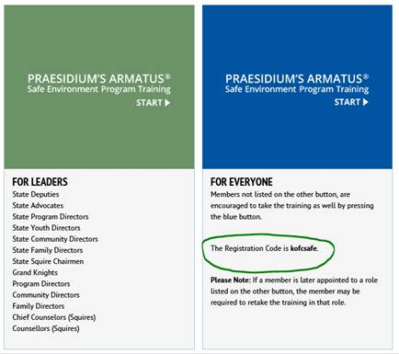
Access Training ONLINE
kofc.org/safe

Slide 16
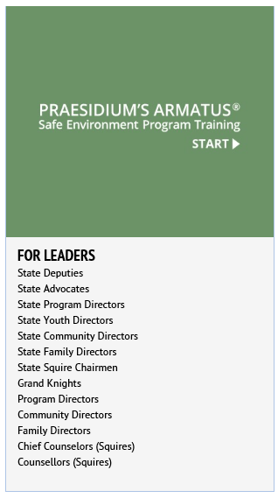
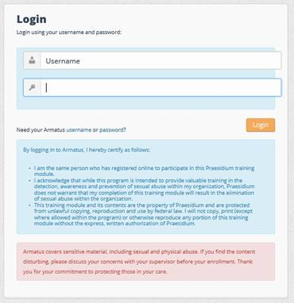
Access Training ONLINE: kofc.org/safe
KEY LEADERS / REQUIRED ROLES - GREEN BUTTON
Use Your Username And Password From Your Email to LOGIN >>>>>>>>>>>>>>>

Slide 17
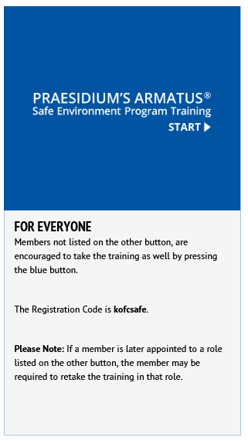
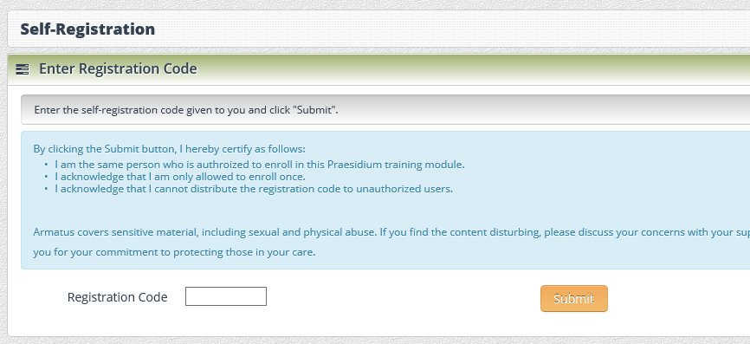
Access Training ONLINE: kofc.org/safe
All Other Members - BLUE BUTTON
Enter Registration Code: kofcsafe >>>>>>>

Slide 18
Encourage Members with NO EMAIL on File
To Please, set one up today!
OFFICE OF YOUTH PROTECTION mails members with NO EMAIL their username and password AND, if applicable, a background check authorization/consent
All members are STRONGLY ENCOURAGED to share their personal email with the Knights of Columbus OR to set up a personal email account as soon as practicable
Provides a means of SUPERIOR communication for key leaders to remain informed of the Order’s programs and initiatives

Slide 19
Protecting Our Children:
A Program For Families

Slide 20

PROTECTING OUR CHILDREN:
A Program For Families
Protecting Our Children: A Family’s Response to Sexual Abuse, a short documentary film produced by the Knights of Columbus.
Offers families a deeply personal and practical account of how one Knight and his family addressed their son’s abuse by a close family friend.
Presents parents with the scope and scale of the risks families face from sexual abuse in today’s society and provides them with knowledge and concrete steps they can follow to help keep their children safe.
Streaming at kofc.org/safe
Guide For Families and Quick Reference Guide at kofc.org/safe
English; Coming Soon - Spanish, French, and Polish

Slide 21
Officers’ Desk Reference

Slide 22
Officers’ Desk Reference
Offers practical guidance for state and local officers on various matters relating to Knights of Columbus councils and assemblies
District Deputies, State Advocates, and State Deputies should address how policies and procedures contained in the Officers' Desk Reference may apply in specific cases
District Deputies, State Advocates, and State Deputies should direct questions they have to the Supreme Advocate's Office at advocate@kofc.org

Slide 23
Office of the Supreme Advocate
Office of Youth Protection
Thank You

