Slide 1

Safe Environment
Program
OVERVIEW
Knights of Columbus
Office of Youth Protection

Slide 2

WHY does Knights of Columbus have a Safe Environment Program?

Slide 3
To Protect Those We Serve
The Knights of Columbus takes very seriously its commitment to protect children and other vulnerable persons. When Brother Knights protect children and other vulnerable persons they serve, they live out their VOCATION of FATHERHOOD. In the words of Supreme Knight Patrick Kelly: “Protecting our children is the sacred duty of every Knight.” This is why the Knights of Columbus has a policy of ZERO TOLERANCE with respect to abuse. This crime directly contradicts the identity and mission of the Knights of Columbus and has no place in the Order.
The Knights of Columbus Safe Environment Program kofc.org/safe

Slide 4
The Knights of Columbus Safe Environment Program
Consists of safeguarding policies and procedures most suited to the mission and identity of the Knights of Columbus, regardless of the location of councils and members.
Includes abuse awareness and prevention training and screening, including a background check for members in key leadership roles.
Background checks are limited to national and state/provincial sex offender, criminal, and motor vehicle databases ONLY
Background checks do NOT include any other search, such as “credit checks,” etc.

Slide 5
Councils Must Fill and Submit
Forms 185 and 365
Enter all appointments online via member management
There must be a Grand Knight assigned via Form 185
There must be three different members assigned to the Program, Community, and Family Director roles assigned via Form 365
Watch this video to learn how to submit online: https://players.brightcove.net/802593642001/y6FLiIa0f_default/index.html?videoId=6191938577001
District Deputy

Slide 6
 Grand Knight – training
 Program Director – training
 Family Director – training; background check
 Community Director – training; background check
*Grand Knights may only hold one of the additional director roles listed above
*If the council sponsors a Columbian Squires Circle, that circle must also be compliant for the council to be compliant
Key Leaders in Required Roles
District Deputy

Slide 7
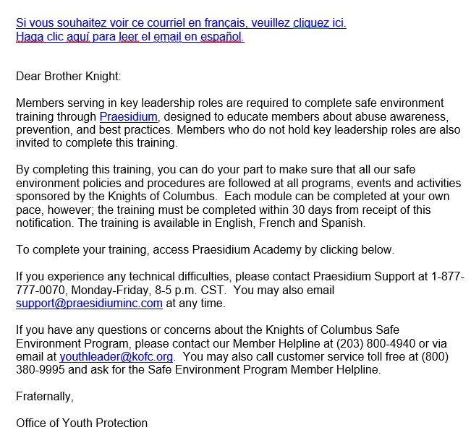
Praesidium – our partner in safe environments
Once Forms 185 & 365 are processed, Praesidium sends appointed members this email to access their requirements
It contains active blue hyperlinks for SEP website & this email in French and Spanish
District Deputy

Slide 8
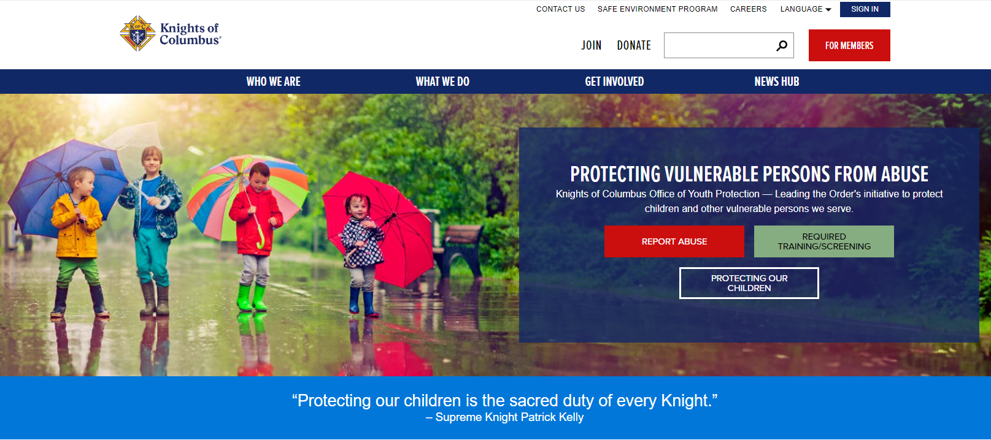
Or, Access Training ONLINE: kofc.org/safe
Click Required Training & Screening

Slide 9

Access Training ONLINE: kofc.org/safe
This sign in ONLY works for members who have accessed Academy in the past and wish to view their transcripts, or who have been assigned safe environment training or background checks based on their current role
District Deputy

Slide 10
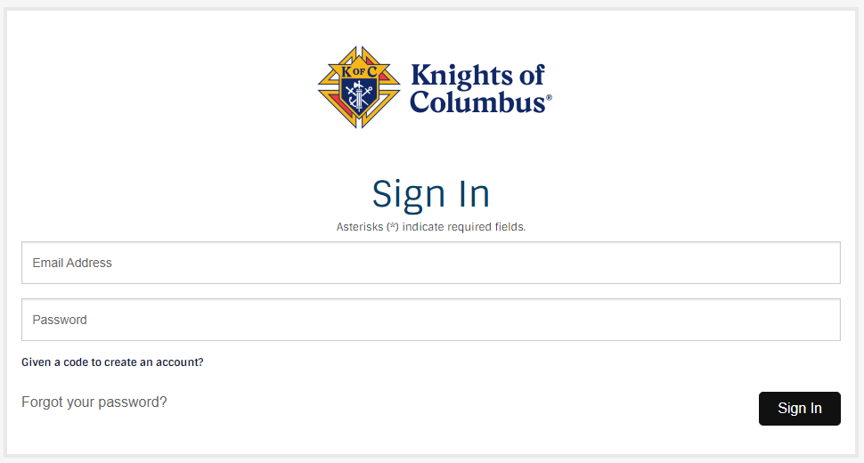
ONLINE Training & Background Check Sign-in:
District Deputy

Slide 11
ONLINE Training & Background Check Sign-in:
Enter your unique email address, that is on file with the Order, as the username
If you do not remember your password or you never created a password, you must select “forgot password”
Praesidium will then send you an email with further instructions
District Deputy

Slide 12
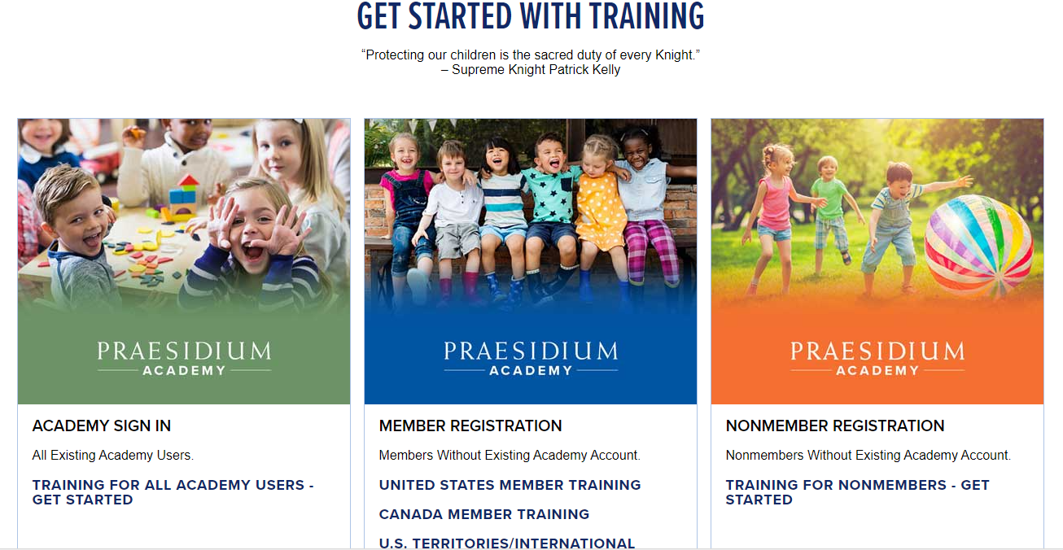
ACADEMY Sign-in Page
The Sign-In portal for existing accounts (green) is active
Access to the Member Self-Registration (blue) & Non-Member (orange) portals is targeted to reopen in 2025; these are for FIRST TIME USERS ONLY.
Existing users must sign-in via the green button.

Slide 13

Self-Registration Portal Message
Those attempting to access the Order’s safe environment training via the Self-registration paths will receive this message: “Sorry, this code has expired and is no longer valid.” Again, thank you for your patience.

Slide 14
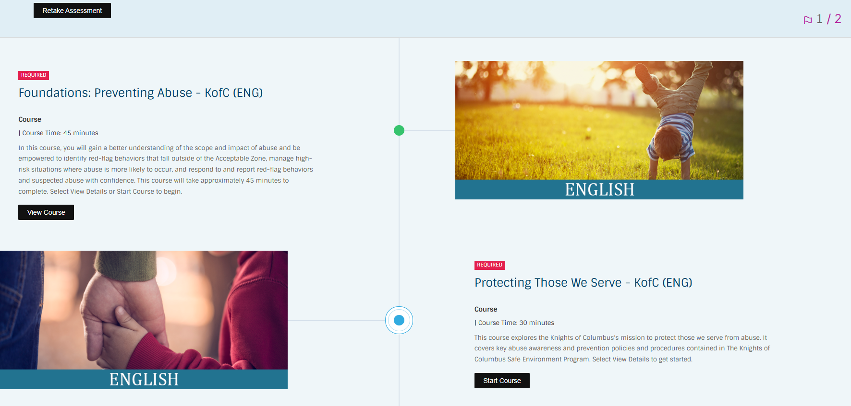
View of Assigned Training courses in Praesidium Academy
There are two training courses that must be completed. If one course reads “View Course” that means you have already completed it. If the second course reads “Start Course” that means that the second course still needs to be completed. Certain roles also require a background check and that will be listed here as well.
District Deputy

Slide 15
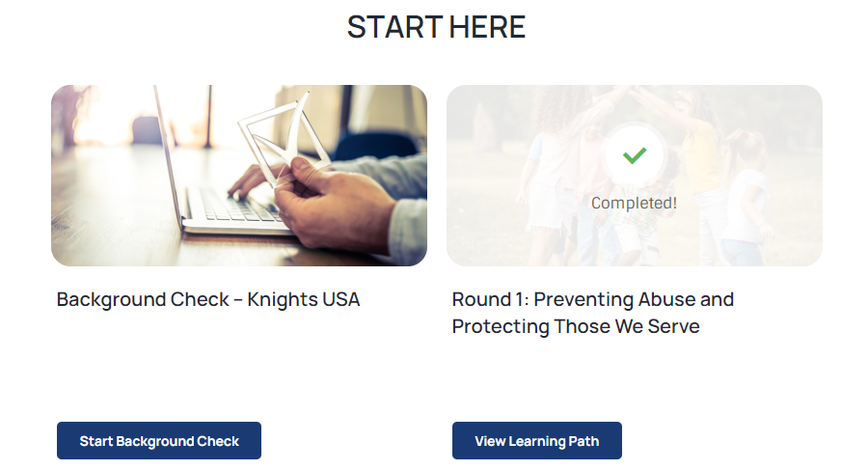
View of Assigned Background Check in Praesidium Academy
Here is an example of a member who completed both training courses but has not yet started the assigned background check. He must click on the “Start Background Check’ button to provide the required information.
District Deputy

Slide 16
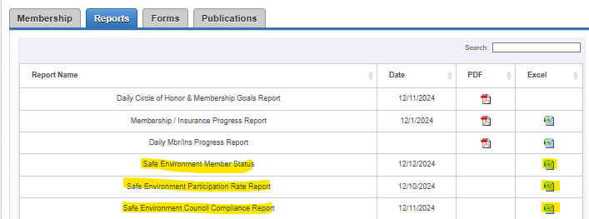
Members with access to Officers Online may view the current compliance status of their council(s) by clicking on the Reports tab
They all have access to view the safe environment reports in Officers Online by clicking on the Reports tab.
How to Interpret Safe Environment Program (SEP) Reports is a useful guide that can be found here and under Leadership Resources on the Kofc.org/safe page. Use this to better understand how to use each of the above reports.

Slide 17
Knights of Columbus
OFFICE OF YOUTH PROTECTION
Member Helpline – 203.800.4940
youthleader@kofc.org
kofc.org/safe

