Slide 1
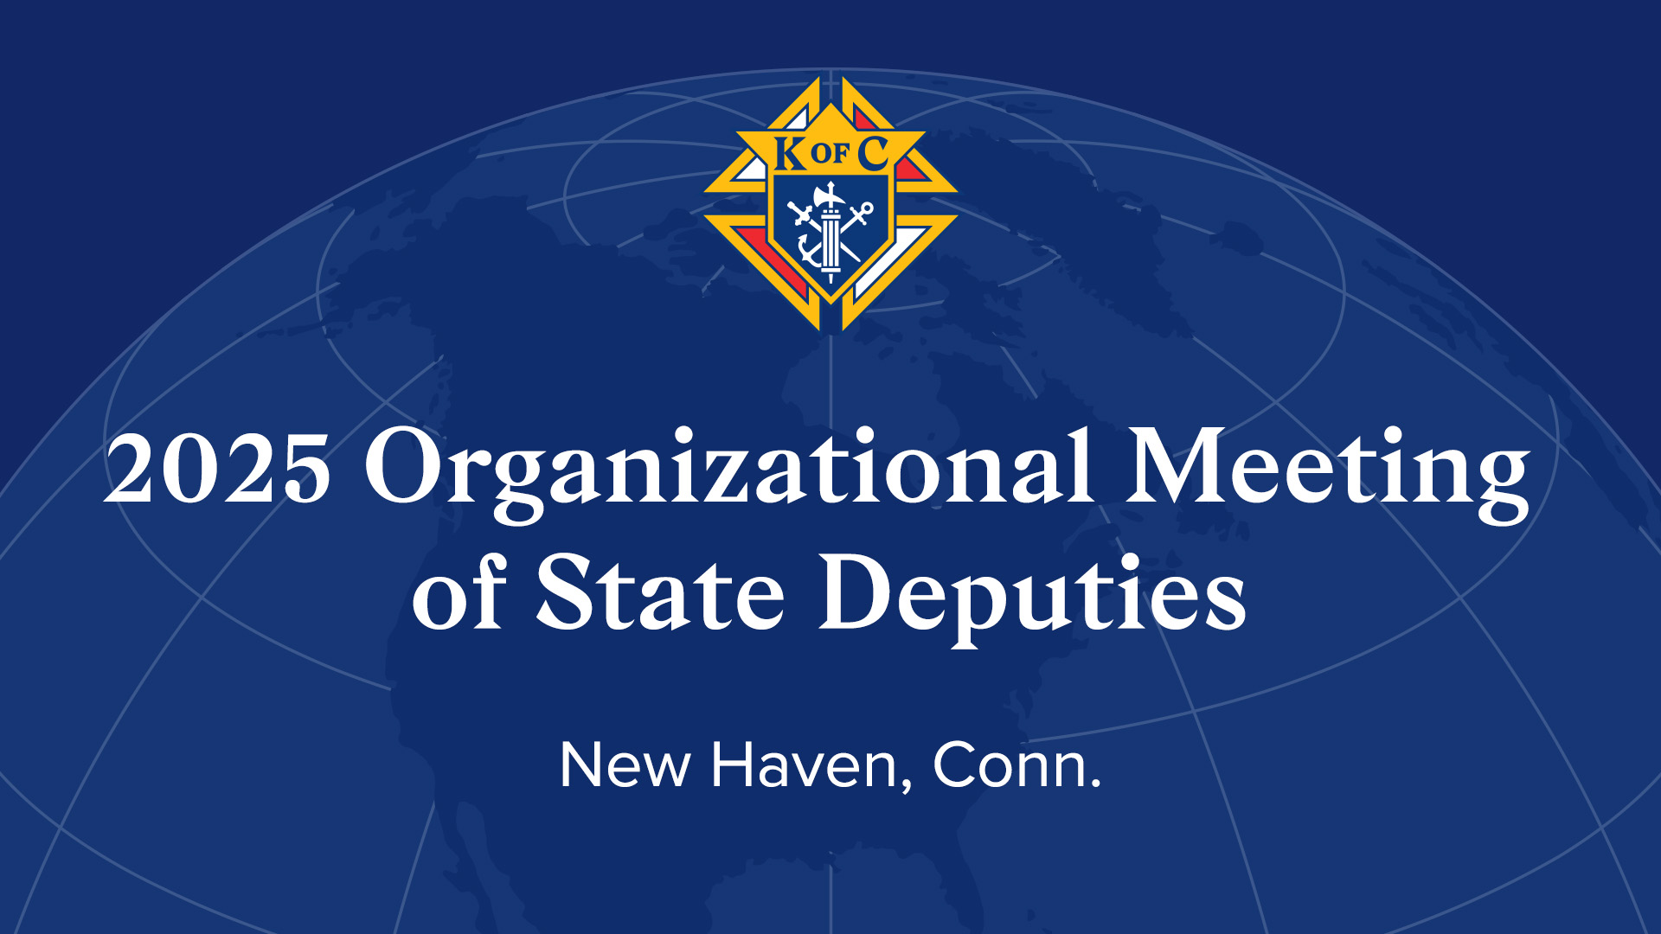

Slide 2
State Deputy 101 – Fraternal Operations & Membership Growth
Jack Leibowitz – Manager of Council Data Ceremonials & Council Experience jack.leibowitz@kofc.org
Aaron Ferguson – Manager of Field Support aaron.ferguson@kofc.org

Slide 3
Officers Online
Login Starts with a State 365
Access to various Reports, Forms, and Publications
    Circle of Honor Report
    Membership Insurance Progress Report
    Safe Environment Report
    State Deputy report

Slide 4
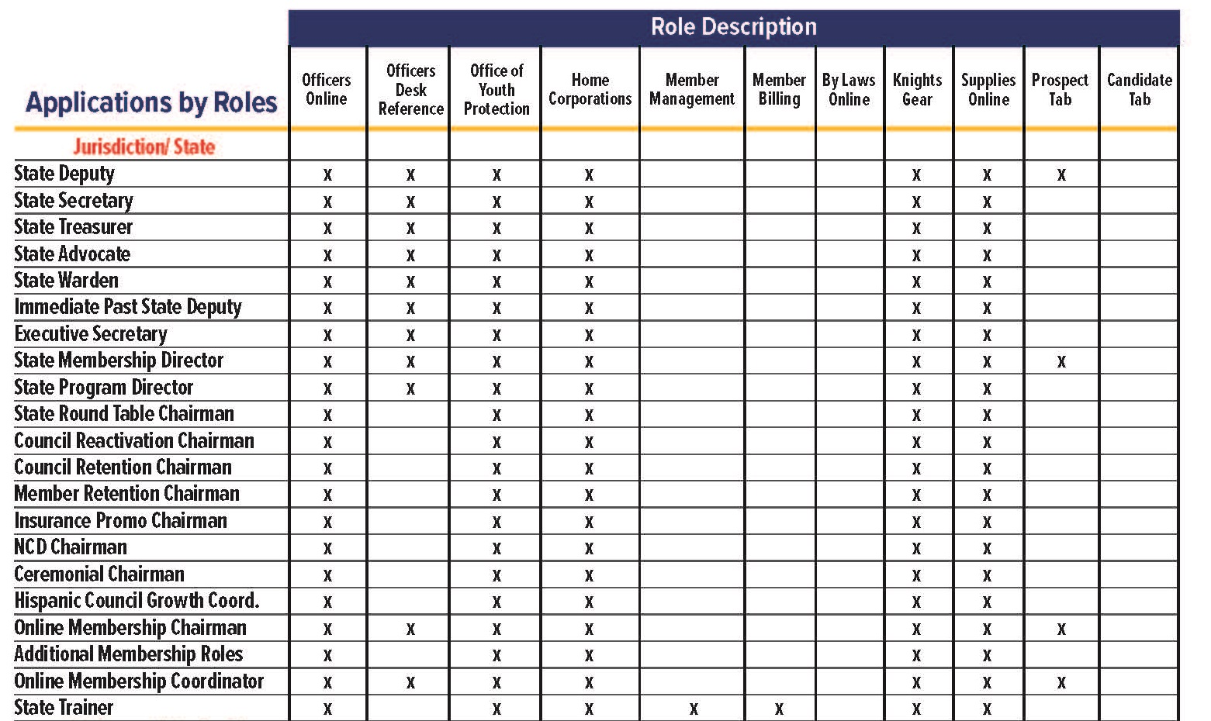

Slide 5
Teams – SharePoint
SharePoint center for data and report uploads
Most reports updated weekly
Used in partnership with Officer Online reports
Access is shared with a select audience (reported on State 365)
Role | Access
State Deputy | All Data
State Secretary | All Data
Membership Director | Membership Data
Program Director | Programs data
Faith Director | Programs data
Family Director | Programs data
Community Director | Programs data
Life Director | Programs data
EFF Director | Cor data
Awards/Reports Forms Director | Awards data

Slide 6

How to log in
Please do not use your mobile device!!
We recommend using a desktop or laptop for optimal user experience

Slide 7
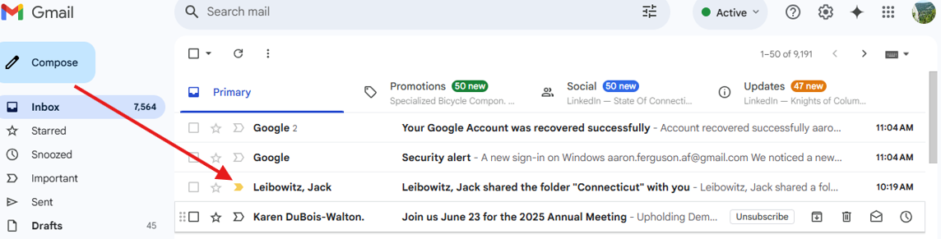
How to log in
You will receive a notification in your email from a KofC employee.

Slide 8
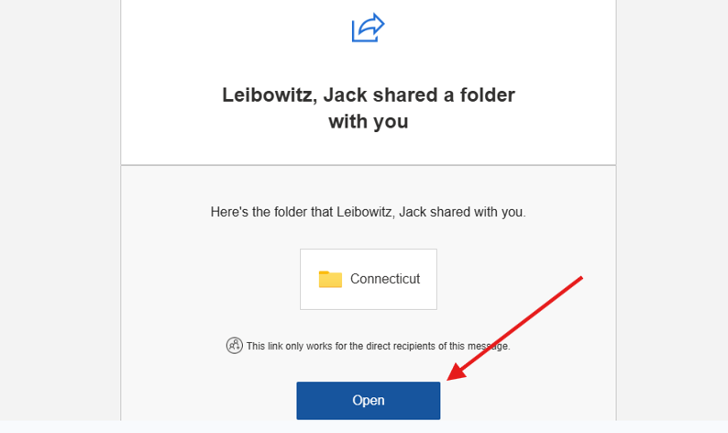
How to log in
Click to Open.

Slide 9
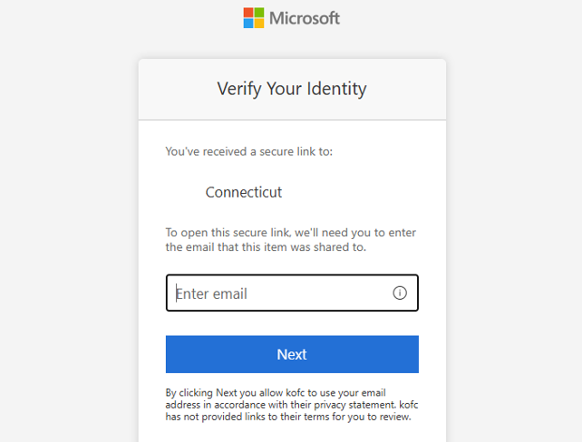
How to log in – Verify Identity
Enter the same email address that you received the invitation.

Slide 10
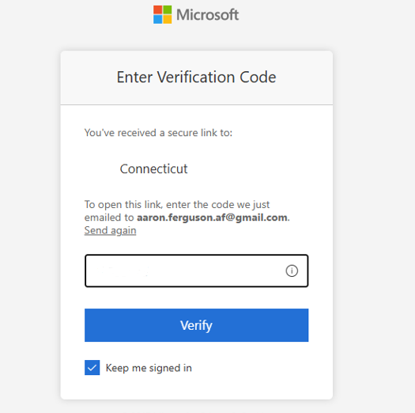
How to log in – Verify Identity
Where is my code?
Return to your inbox

Slide 11
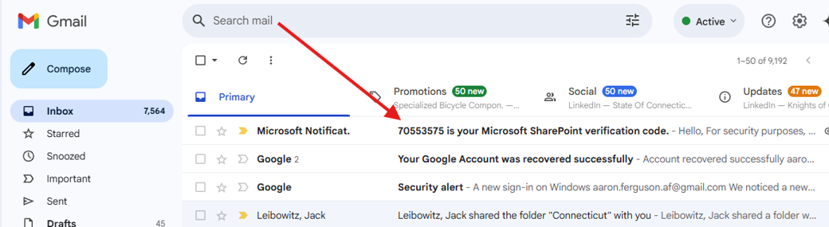
How to log in – Verify Identity
Copy your code from the Microsoft Email

Slide 12
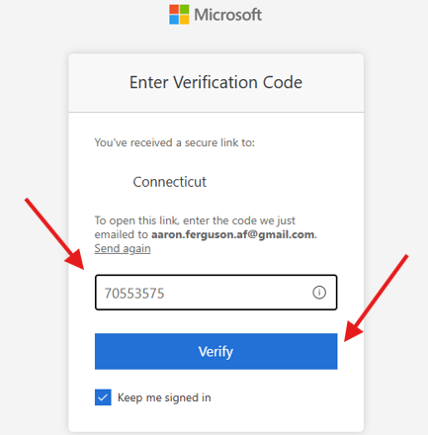
How to log in – Verify Identity
Paste your Code and press ‘Verify’

Slide 13
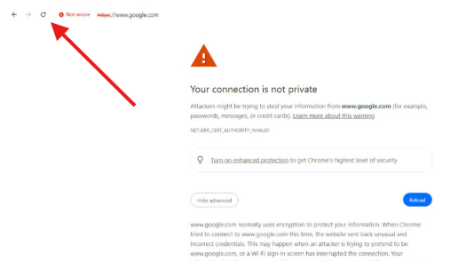
Possible Firewall Error – Just hit refresh

Slide 14
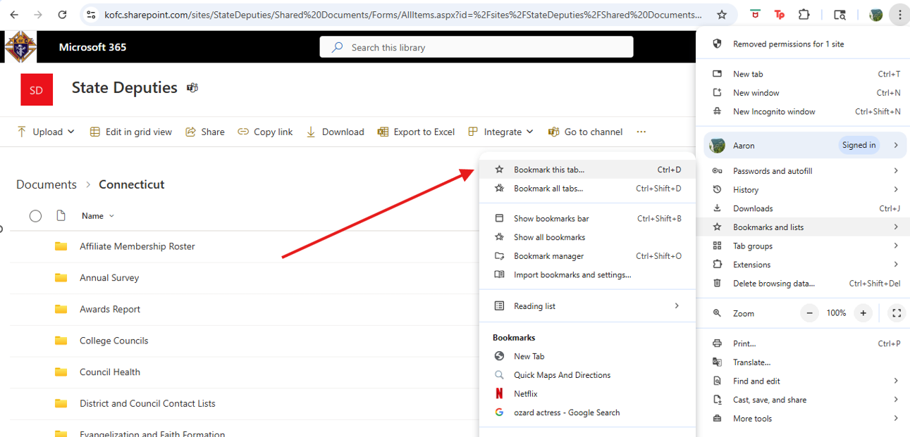
You’re in!! – But don’t forget to bookmark

Slide 15
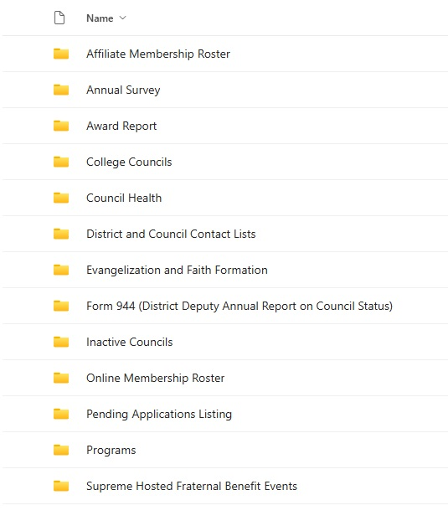
Teams - SharePoint
Affiliate Membership Data
Annual Survey Results
Council & District Award Progress
Council Health Data
Officer Contact Lists
Form 944 Submission and Summary
Online Membership Data
Programs Data
Supreme Hosted FBE Data

Slide 16
Who to Contact
Trouble Logging into Officers Online?
    Customer Service (800) 380-9995
Submitting or Editing State 365
    FraternalMission@kofc.org
Trouble Logging In to Teams - SharePoint?
    FraternalMission@kofc.org

Slide 17
New Council Development
    Form 133 - Notice of Intent to create a New Council
      Email to councilgrowth@kofc.org
    Council Growth will send you a Canvasser Kit
    Council Growth will reply with an informational email.

Slide 18
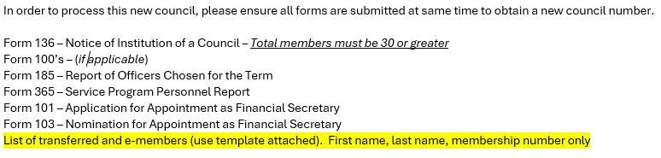
NCD Reply Email

Slide 19
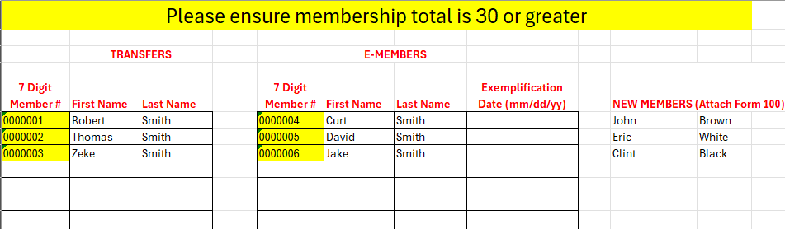
Transfers and E members

Slide 20
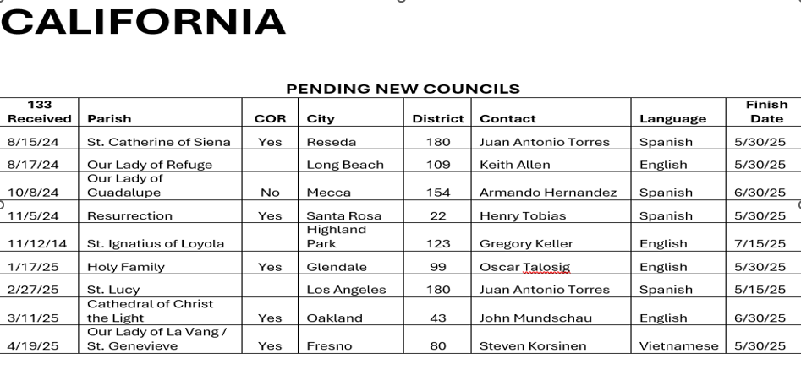
Pending NCD and Reactivations

Slide 21
Q & A

Slide 22
State Deputy 101 – Fraternal Operations & Membership Growth
Jack Leibowitz – Manager of Council Data Ceremonials & Council Experience jack.leibowitz@kofc.org
Aaron Ferguson – Manager of Field Support aaron.ferguson@kofc.org

Slide 23
Walkthrough OO
Walkthrough Teams
Q&A
Reports to Showcase
    Pending Applications
    Awards Progress Report
    944 feedback
    ASAP Data

