Slide 1


Slide 2
State Deputy Meeting
6/5/2025
Notes:
Welcome and thank you for taking the time to enhance your PowerPoint creation skills. In this session we will look at the KofC brand template, it’s design features, color schemes, text and picture layouts, and best practices.
At the end I will demonstrate how to save this template as a permanent feature and review some basic functions.

Slide 3
Presenter
  Matthew DiCalogero, LUTCF, CRPC
    BA Stonehill College
    MBA Boston College
  Married with 3 children
  General Agent- Massachusetts
  Member Council 5231, Medfield, MA
  Joined KofC 2007, been agent since 2013
  3rd Generation agent with KofC
Notes:
In 2020 the order updated it’s branding, part of that was creating a brand specific PowerPoint template. The fraternal operations department has worked with the template and refined it so it can be used to deliver our messages Across all departments with consistency in visual imagery, text, and color schemes.
We have not changed the design parameters of the PowerPoint template because it provide a lot of flexibility to work images and wording to deliver our message as effectively as possible.
This design template is meant for a wide screen broadcast. Please keep in mind, especially for staff, who may be using a host’s projector or TV, the ability to display in a wide screen format is required..
With the amount of flexibility built into this template there is no need to alter change or create something new. keeping in line with that first bullet point our goal here is to create consistency with how we are presenting our message to our members and business partners.
One thing that we do not go into detail in this presentation, but I would like to mention now is the use of animations. PowerPoint has several animations and slide transitions that can be incorporated to enhance the delivery of a presentation. However, not all animation and transitions have professional appeal. If animations are a part of the presentation you are creating, we ask you to please use the ‘appear’ animation

Slide 4
Insurance & Fraternal
WE ARE ON THE SAME TEAM with the SAME GOALS
  MEMBERSHIP GROWTH
  FBN
  Star Council
  Let’s work together to grow the KofC
Notes:
This template contains many layout options for your presentation. Each Layout has built-in formats for text, pictures or graphics, charts and tables.
Every layout option indicated its best use within the presentation. Most layout options have some additional customization that can be utilized to best deliver your message.
We’ll look at a few of these layouts, highlighting where they're best used and what customizations are available.

Slide 5

Playbook to Success
  Build relationship with GA
  Understand each other’s roles
  Set goals and expectations
  Keep lines of communication open
    Quarterly check in

Slide 6
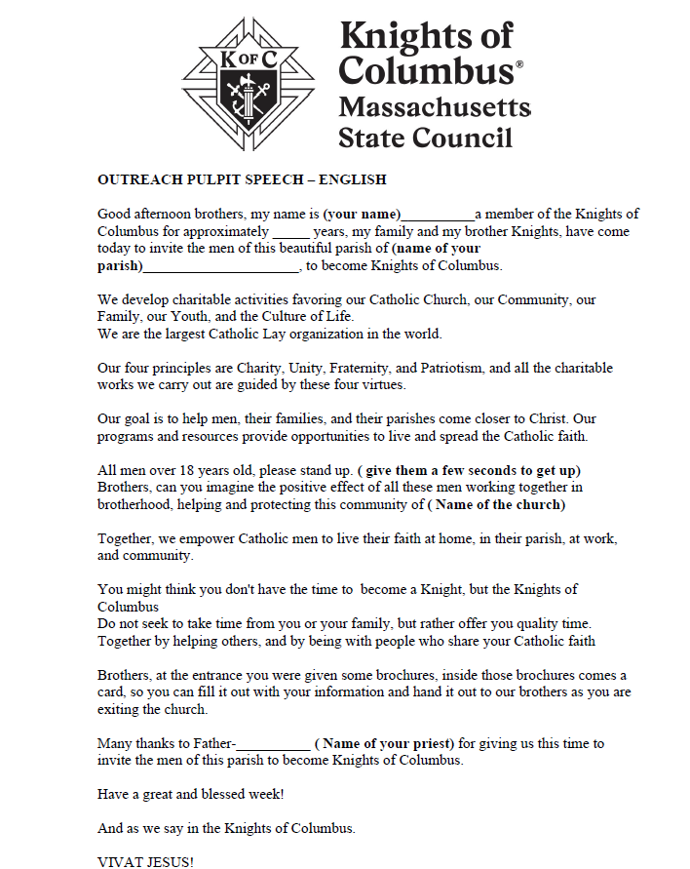
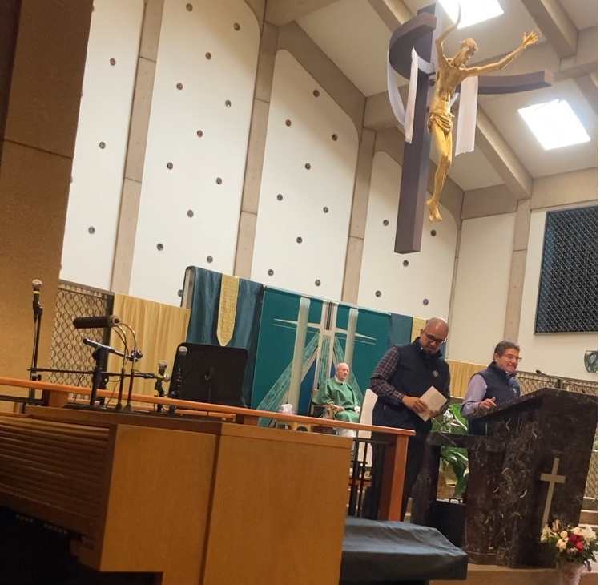
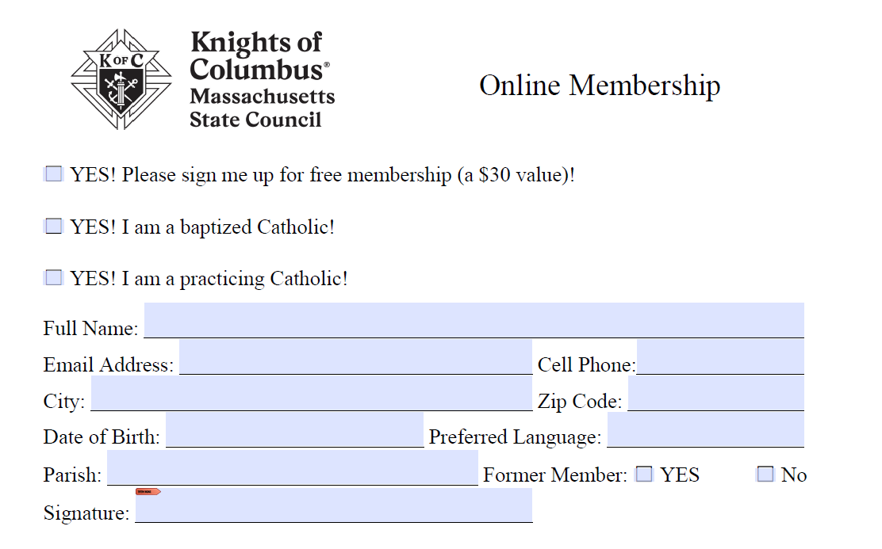
Key Metric- Membership Growth
  SOURIT
Cover all doors to hand out Membership paper with golf pencil as men walk into Church
Speak at pulpit for 3 minutes, read pre-determine Pulpit speech
Collect membership cards as men leave Church
In one weekend, we brought in 30 new members from this marketing technique
Notes:
Sometimes the focus of a particular slide will be to highlight an image with a caption. This option, like a title slide, displays the picture very prominently with large bold fonts for our message. Most of the content slides allows for multiple pictures, the ability to resize and place them, or the text box, in different areas on this slide.

Slide 7
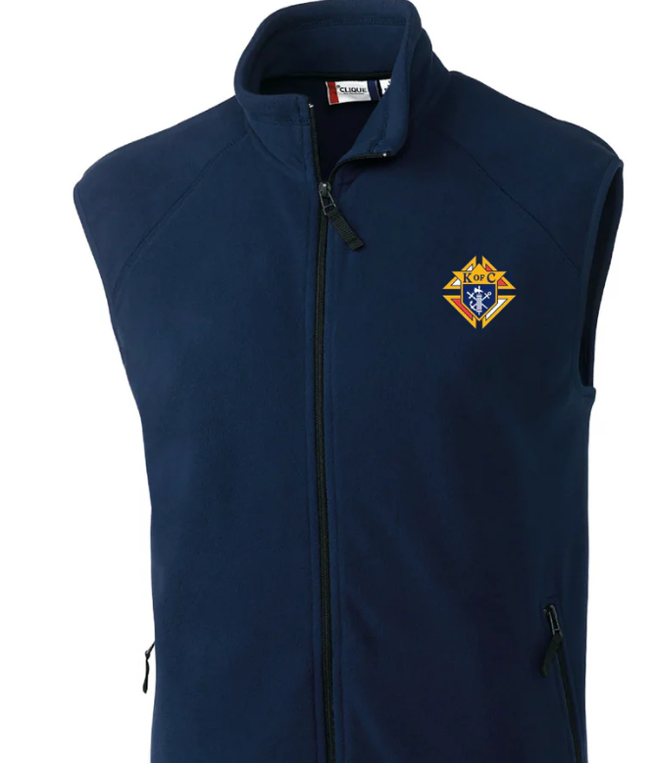
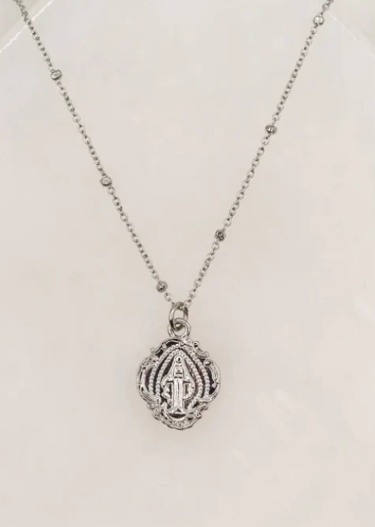
Before Event
Vest to Pastor
    Key- get Priest onboard with recruiting idea
KofC Necklace to rectory Admin
    Builds goodwill and brand awareness
  Coordination between agents and council to volunteer
Notes:
There are a few items to be mindful of when building a PowerPoint presentation. First is overcrowding the slide with too many words, sentences, and paragraphs.
The PowerPoint should be thought of as a prop used by the presenter and not the presentation itself. This is a visual aid that guides the audience through the thought process and the message that we are delivering to them. When we overcrowd the slide, the audience spends more time trying to read and decipher what has been displayed rather than listening to the information we're trying to deliver.
Likewise with bullet points, they should be kept to just a handful of words and not a word for word verbatim of your speaking points.

Slide 8
Day of Event
Set up table at back of church w/ Guard.Grow.Give T shirts, other KofC materials
2 Members at each door to hand our grey membership card with golf pencil as prospects walk into Mass
Either agent or Council member speaks at pulpit at end of Mass (pre-determined script). If you sign up today, free t-shirt
As parishioners leave Church, collect completed card
Notes:
There are a few items to be mindful of when building a PowerPoint presentation. First is overcrowding the slide with too many words, sentences, and paragraphs.
The PowerPoint should be thought of as a prop used by the presenter and not the presentation itself. This is a visual aid that guides the audience through the thought process and the message that we are delivering to them. When we overcrowd the slide, the audience spends more time trying to read and decipher what has been displayed rather than listening to the information we're trying to deliver.
Likewise with bullet points, they should be kept to just a handful of words and not a word for word verbatim of your speaking points.

Slide 9
After Event
Agent calls prospects to ensure they “click” confirmation email to make e-membership official
Agent should schedule meeting to review benefits of membership
Work with GA to schedule these events and track results
Notes:
There are a few items to be mindful of when building a PowerPoint presentation. First is overcrowding the slide with too many words, sentences, and paragraphs.
The PowerPoint should be thought of as a prop used by the presenter and not the presentation itself. This is a visual aid that guides the audience through the thought process and the message that we are delivering to them. When we overcrowd the slide, the audience spends more time trying to read and decipher what has been displayed rather than listening to the information we're trying to deliver.
Likewise with bullet points, they should be kept to just a handful of words and not a word for word verbatim of your speaking points.

Slide 10
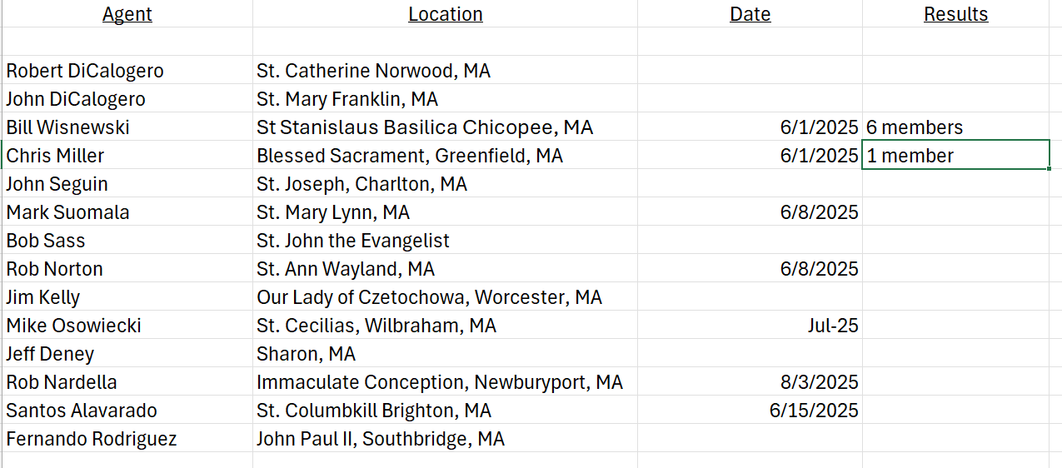
Membership Recruiting in the Parish
Notes:
The biggest key when it comes to our efforts in bringing consistency across the board, is the font type, color, size and spacing that we use. There is a rainbow of color and style options available to us when it comes to font. In our research we have found that the white font on the dark blue background delivers the clearest image. It's easy to read, easy on the eyes, and clarity is not affected when been viewed either on a computer screen or a 50-foot projection.
We also established the aerial font type because of the visual clarity it offers. For ease of use, this template has the font style size and spacing built into it. However, if you are building a slide using a blank page, this is how your text should look.
Slide heading or title aerial black as the font size 36.
When we step down to the main body of our content aerial font size 28 bold and line spacing set to 1 ½.
This is the same for the first level bullets points. If your presentation has second and third level bullet points, it drops to a size 24 font bold and single line spacing.

Slide 11
Thank you!
Vivat Jesus!
Notes:
Thank you for viewing this session and helping us to create consistency across the KofC Brand.

